Slide 1

2021 Golden ideas ranking（First half year）
Golden Idea Award：
Ben Franz Lazarte（PH）
Beenish Shahid
（PK）
Zeeshan Khalid
（PK）
Mostafa Abdelaleem
（EG）
Debby Fearry
（ID）
Safaa
（MA）
Encouragement Award：
Feriyal Nurdiansyah
（ID）
Keo Nary
（KH）
Hari Muliafit
（ID）
Tayyaba Mughal
（PK）
Jason Leong Jie Sheng
（MY）
Mojana Amado Jr（PH）
Nico Putra Widjanarko
（ID）
Zuraida Yamin（ID）

Slide 2
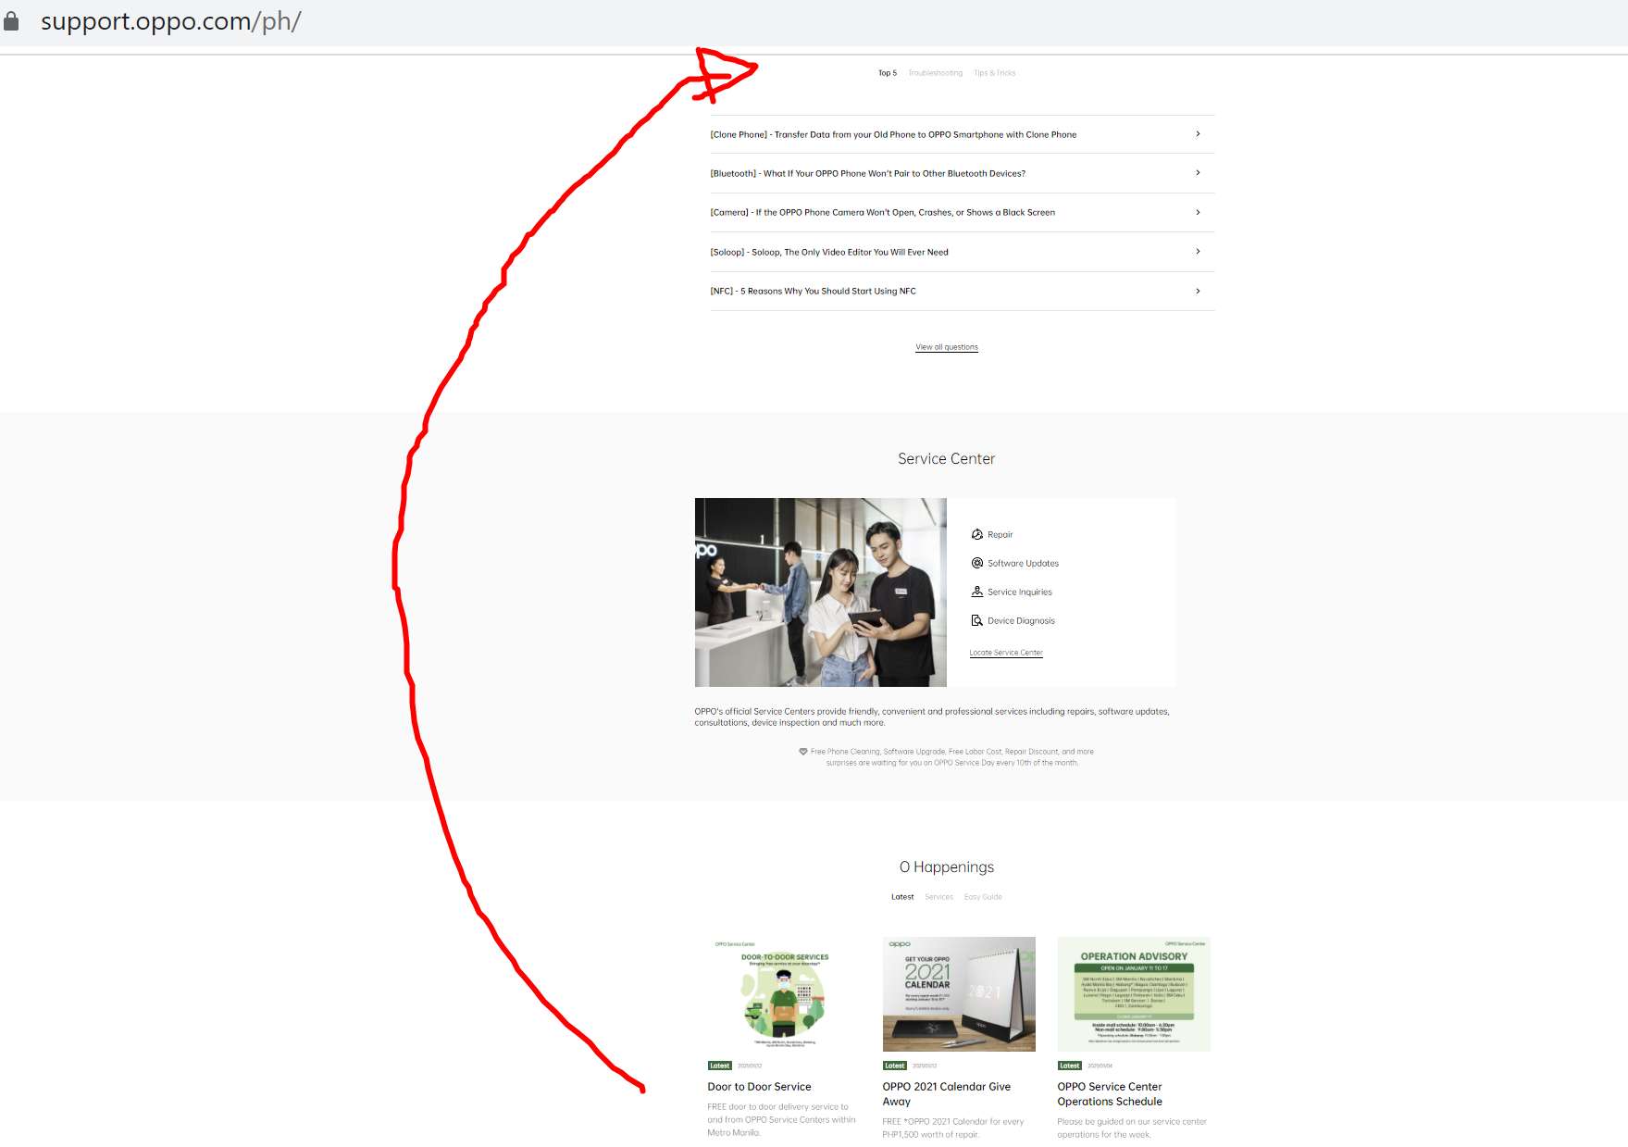
Golden Idea Award（1/6） : O-Happenings Promotions
Proposer : Ben Franz Lazarte
Area | Golden idea description | Pictures
PH | Related with which service concept：Convenient | Related pictures:
 | Background: Customers always try to visit OPPO social media account and Website to gather information regarding OPPO Customer Service Promotions and Discounts as they might get information.
 | Current problems: In OPPO Support Website layout the O-Happenings is located on the second to lowest portion of the website on which customers and potential customers will not directly see our promotions. Thus we are not effective enough in promoting our services to customers for their convenience.
 | Your golden idea： Next Page

Slide 3
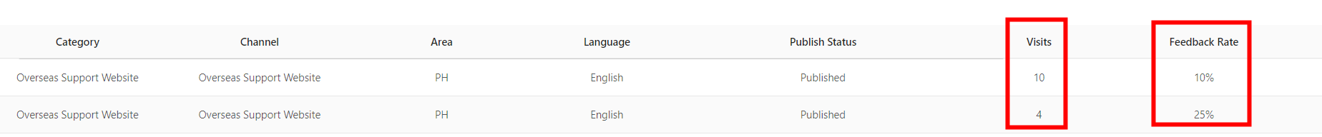
Golden Idea Award （1/6） : O-Happenings Promotions
Proposer : Ben Franz Lazarte
Area | Golden idea description | Pictures
PH | Your golden idea： Overseas Support Web Admin should change the layout of the OPPO support website to increase our site visit and will have productive marketing and promotions of our services to customers. This will provide our customers great convenience than going directly to OPPO Service Center to ask for our promotions and discounts. | Related pictures:
Feedback :
Thanks for this advice, we have received the same from the other markets and HQ plan to move the O happenings to the upper position of the home page.

Slide 4
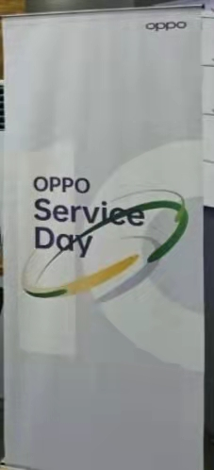
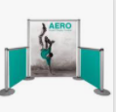

Golden Idea Award（2/6） : Awareness of oppo services !
Proposer : Beenish Shahid
Area | Golden idea description | Pictures
PK | Related with which service concept：Professional | Related pictures:
 | Background: Awareness of oppo services !
 | Current problems: The current problem which is mostly facing by the user is miscommunication most of the customer do not know oppo have these fabulous services: 1-free software update 2-1 hour Repair service 3-free phone disinfect 4-free cleaning so customer cannot avail these offers
 | Your golden idea： So I suggest we need to put some stands and hang any advertisement board in all service center which will give awareness to the customers about our services .For Example One customer came in our service center for repair his phone he will repair his phone pay for it and go back, so I think when he sit in rest area so he will see our services which is good for their awareness , and in future he /she can acknowledge to their friends & relatives about our services.

Slide 5
Golden Idea Award（2/6） : Awareness of oppo services !
Proposer: Beenish Shahid
Feedback :
It is a good suggestion of how to make use of all the channels in Service Center. One of the value of service promotion is to strengthen users acknowledge of OPPO Service, and cover more user groups.
In point of the awareness to improve exposure of service benefits, and the insights of advantages analysis, I think this is a good golden idea.
However, I want to add a small point here, sending massage may not be the most appropriate way, besides the reasons of docking message sending system, it may have the risk of interrupting users, in some regions these may go against the laws and users privacy. Instead, we can think about make use of MY OPPO even including the PUSH, as users have the rights to close it if they don't want to see it.

Slide 6
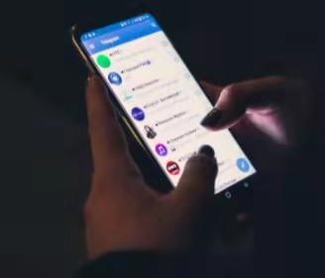
Golden Idea Award（3/6） : Awareness of oppo services !
Proposer : Zeeshan Khalid
Area | Golden idea description | Pictures
PK | Related with which service concept：Professional | Related pictures:
 | Background: Massaging service is still one of the most-loved features of smartphones. It’s also one of the most engaging when it comes to interacting with customers because smartphones are ubiquitous. You have the power to send a text advertisement to your customers. Despite flashier app development and advanced features, SMS technology has endured. The Golden idea that i would like to suggest is about the “Massaging Service Before and After Repair” the detail about this content is written below:
 | Current problems: The current problem which is mostly facing by the user is miscommunication from service staff as well as market which may effects to our feedback. When customer experience bad service which is our first priority may effected to our brand value, so we provide easy and convenient way to our valued customer that is massaging service.
 | Your golden idea： A massage send to every mobile network in over all the Pakistan.Which contain the information about nearest OPPO service center,address,phone number,business hour.On the special occasion like service day, Eid,Christmas day about the discount or promotions and special services for the OPPO user i.e free software upgrade, Free Phone Disinfected Service,1hour Flash Fix,Free Labor cost, Accessories etc.

Slide 7
Golden Idea Award（3/6） : Awareness of oppo services !
Proposer : Zeeshan Khalid
Area | Golden idea description | Pictures
PK | After Repaired: The basic concept of after repair is to send the massage about the customer cell phone that is detail about the over all service charges , repair time, business hour . Or if the customer want to talk with call agent to take verification about his/he device provide the help line # as well . This may affect to our business or brand value.
 | Advantages: Can save time sending a massage rather than interrupting with phone call Good for informal information If busy can’t pick up the call at the moment can easily read the massage when getting free. Have a prove to deliver a massage to the customer about the phone repairing Customer take benifit to our discount and promotion Can easily approach to customer about the charges because customer misguide from dealer about the repair charges
Feedback :
Reasonable needs and the ability to improve the user experience.

Slide 8
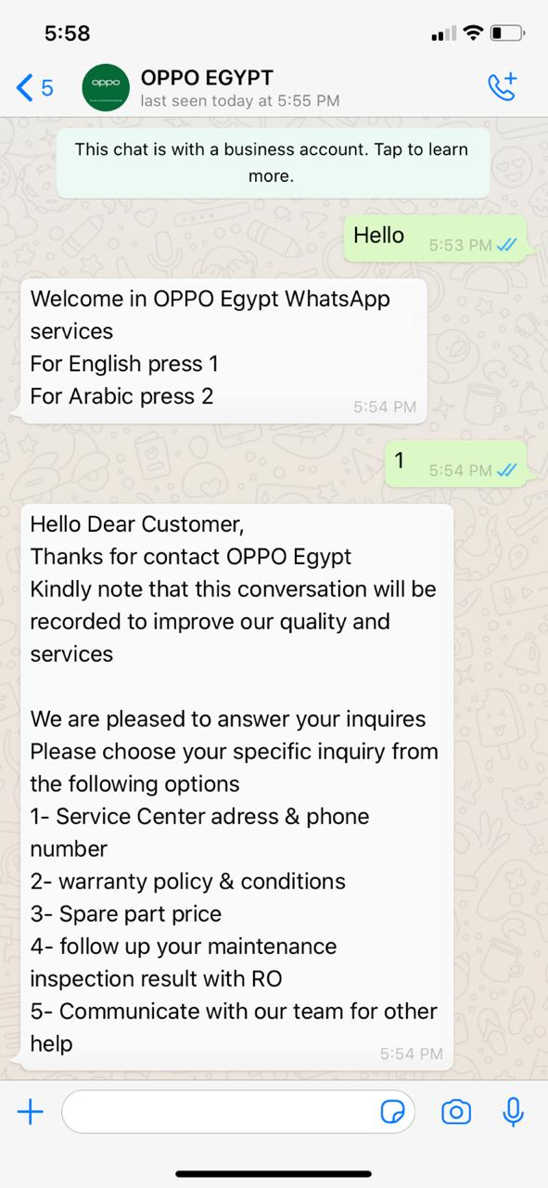
Golden Idea Award（4/6） : Easy & Fast access
Proposer : Mostafa Abdelaleem
Area | Golden idea description | Pictures
EG | Related with which service concept：Convenient | Related pictures:
 | Background: 1. because of the service quantity increase day by day, we have to develop our online services, and make it integrate in our offline service 2. after make simple survey in SC, we found that customer always prefer typing than calling 3. nowadays all customers has internet connection on their phones 4. easy access to our SC is our target, to facilitate deliver our service to customer specially during epidemic period
 | Current problems: 1. some customers complaints that they call our hotline service but sometimes wait long time or have no reply 2. call price make customer come to SC instead of asking through phone, and sometimes their inquires are simple such as spare part price or availability 3. we receive in SCs many complaints that they couldn’t reach us easily because the hotline always busy, and our page sometimes gives late replies 4. sometimes the customer wants to contact the SC itself directly, 5.in the other hand, the SC sometimes need to make call out, but no answer in many times which increase pending time if SC waits customer approve
 | Your golden idea： We will solve this problem by adding WhatsApp services to answer customers inquires and needs in more easy and convenient way 1- it will facilitate customer to achieve us in fast and professional way, and no cost need 2- more credibility, as the customer feel that he can easy access us anywhere anytime, just open his phone and send message 3- enhance 1HFF, as we can inform him the availability of needed spare part in which Service Center, or deliver his spare part to nearest SC to him 4- for company, it will enhance our satisfaction rate, reduce overcrowding inside SC and improve company image
Feedback : Actually, this is undertaken by EG Service Team.
Current Status: EG Local Service Team is purchasing the WhatsApp business account.

Slide 9
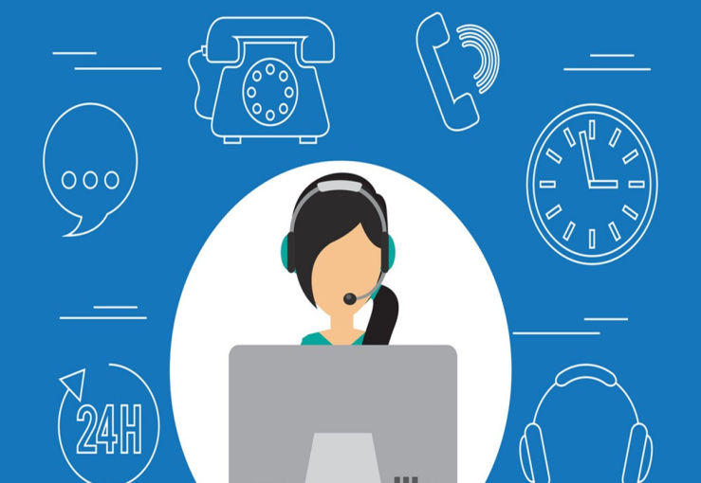
Golden Idea Award（5/6） : Web-based services
Proposer: Debby Fearry
Proposer:
Debby Fearry
Area | Golden idea description | Pictures
ID | Related with which service concept：Convenient | Related pictures:
 | Background: Communication plays an important role in human life along with the very rapid technological developments that occur so that it can make it easier to communicate where Mobile is the basic need of everyone
 | Current problems: Customers will feel satisfied if the company provides services with optimal cellphone service quality, followed by low rates, complaints that are quickly served, access to information is very easy, and the results are very satisfying.
 | Your golden idea： Create a web-based application system for customer service with an attractive appearance and is easy in the process of using it so that customers can do the process of checking the cellphone that has been serviced or not, and also for internal services to collect data on cellphone service services at the OPPO Service Center.
Feedback :
In the next version of the My OPPO App, a user repair history search will be added.

Slide 10
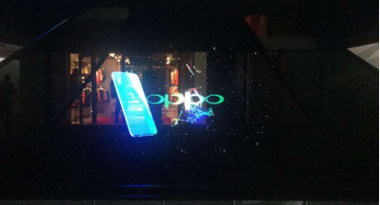
Golden Idea Award（6/6） : Animation during waiting time
Proposer: Safaa
Area | Golden idea description | Pictures
MA | Related with which service concept：Friendly | Related pictures:
 | Background: Entrtainement during waiting time
 | Current problems: During waiting time customer may feel boring and time pass slowly
 | Your golden idea： Our customer journey is critical therefore it's vital to limit stress throughout this journey and not make customers waste their precious time waiting during the repair time or let them feel bored in the service center.If our customers are entertained they will not notice how long they spend in the service center and their overall experience will improve.For this we need to change waiting time preception and in the same time increase satisfaction and my golden idea here is to use more of the new technology by using some 3D, Virtual reality, augmented reality or even holograms.We can create some videos showing 3D animations, create some simulators that will be used by virtual reality VR and augmented reality AR technology, or install some devices showing holograms in the waiting area.The idea here is to give our customers a new and unique experience either by showing tutorials about our devices, how we can use them, how our repair center fixes the devices or showing any other things linked to our company and our coming news so the customer can feel as a member of oppo family and have a quality time while waiting.Since there are already some of our mobile phones like F11, reno 2 or A9 that support VR technology with different glasses and I guess we are already working on oppo glasses, why not provide this technology in our service center.That way we will give our customers a whole new experience by working with them in the present as well as in the future, and that way our customers will be able to pass time exploring our process, our devices and our new ideas in a unique way with avant-garde methods like if we give them a glimpsd of the future. That way they will be surprised by whole new world of innovation that doesn't exist anywhere else.
Feedback :
It’s a good idea to give user a new experience to show our products or service. Actually we are working on it. This year we will create the O-Class in our service centers to teach users how to use our products in a small classroom format.

