Slide 1
Introduction of
Global Knowledge Base
Global Service Center-Knowledge Management Group
4/28/2021
Notes:
Attendance
Training time, Q & A section
Remind to complete the quiz online

Slide 2


Preface
Background：
Since the old knowledge base-Right Now cannot satisfy our need in server response, search engine and user language settings, the new system-Global Knowledge Base wasofficially released on April 20th.
Features
Server Response
2s~5s
Articles in multi-regions available
Indonesian, Thai, Myanmar, Cambodian, etc.,.
More than 60 regions
Multi-dimension contents (OPPO/Realme/OnePlus)
Role Authority
User Language
Available Regions
Contents

Slide 3
Contents
0 1
0 2
0 3
0 4
System Operation
Feedback
Collection
Login
Q&A

Slide 4
How to login
0 1

Slide 5
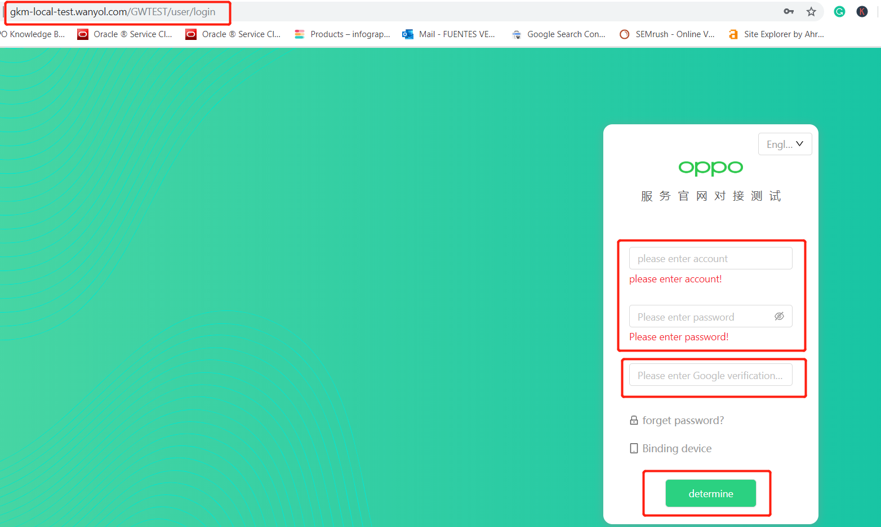
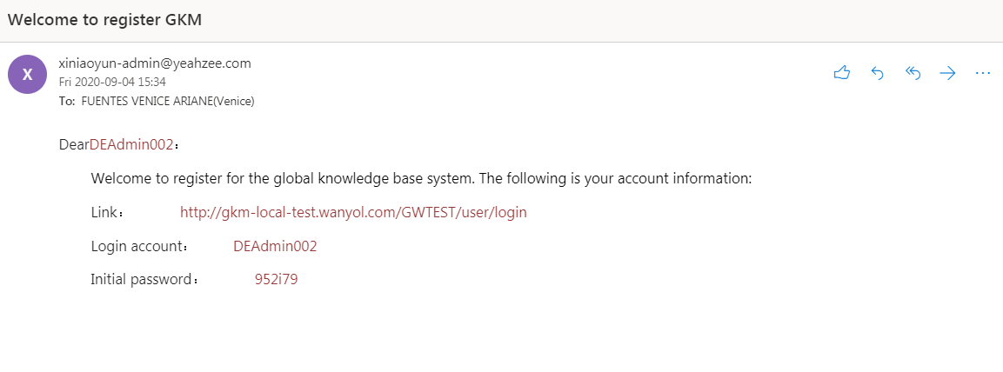
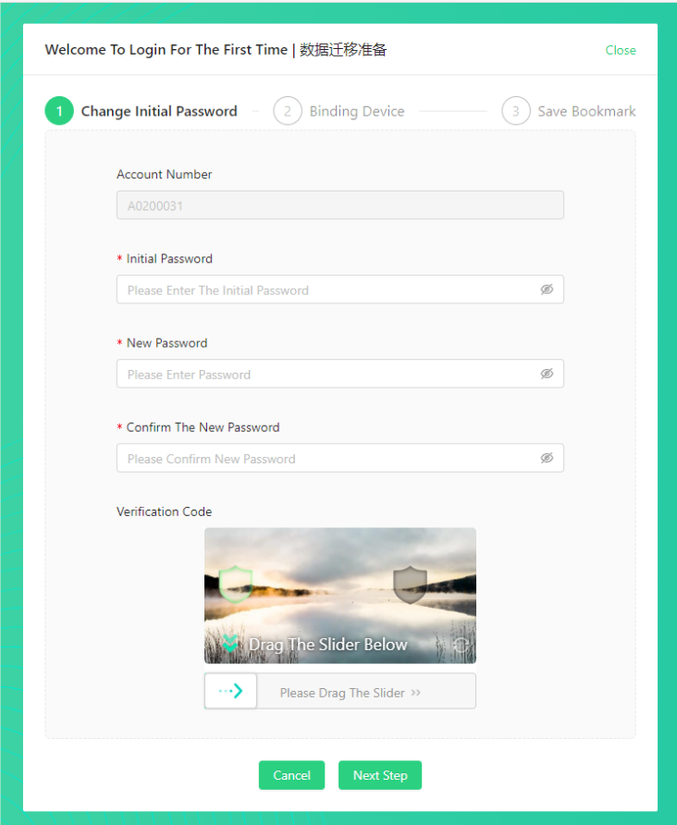
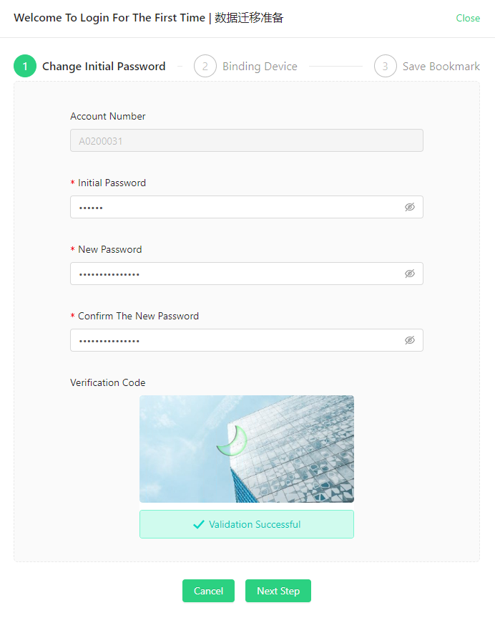
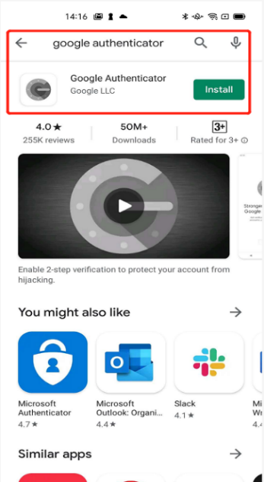
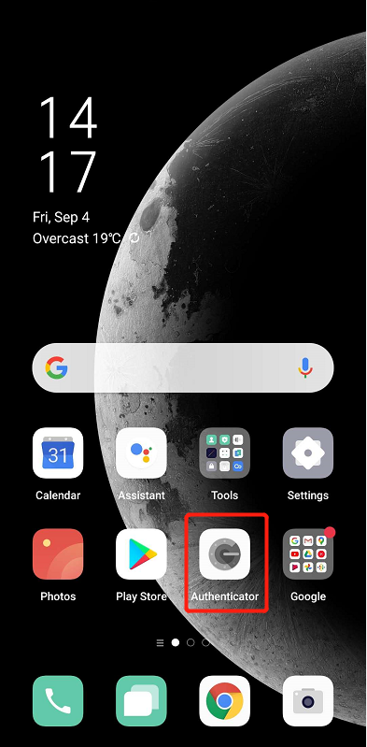
Login GKM without WCSM account
Apply for GKM account registration first. Then you will receive the below email.
2
Copy and paste the system link to any browser
3
1. Input account and initial password received in the email.
2. Input and confirm a new password.
3. Drag the slider until it fits the missing puzzle for security verification.
1
First, search for Google Authenticator on Google Play Store, then install it on your phone.

Slide 6
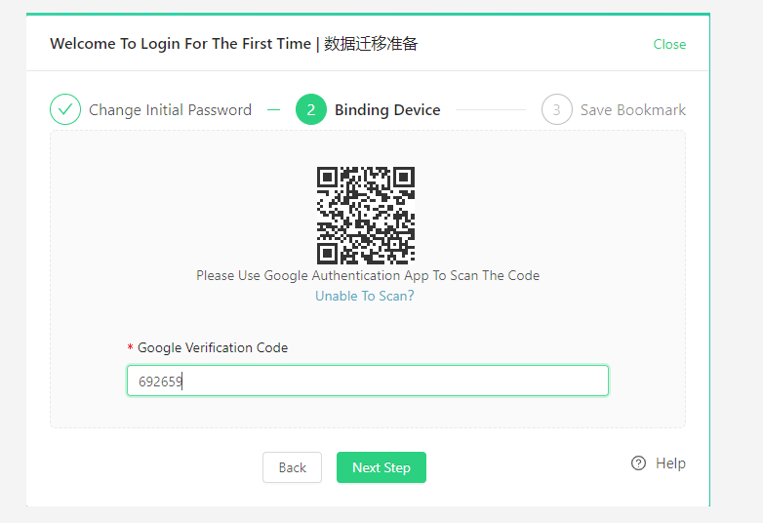
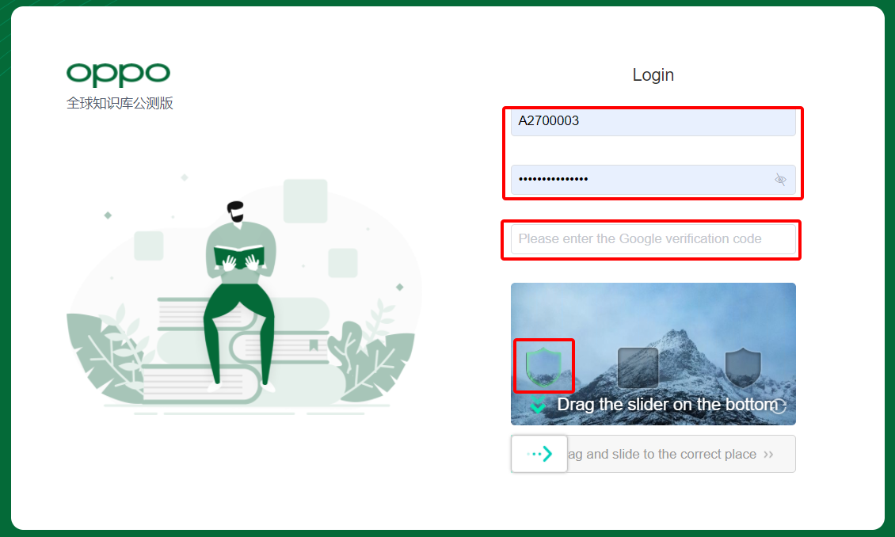
Login GKM without WCSM account
4
5
Scan the QR code using the Google Authenticator & it will ask you to add the account-tap Add Account.
Input the Google Authentication number. Make it fast as it changes every 30 seconds.
Click Next Step.
You have successfully bound your account to the GKM System.
1. Once you bound your account, you need to input the Google Authenticator Code again.
2. Drag the slider for security verification.
3. Login successfully.

Slide 7
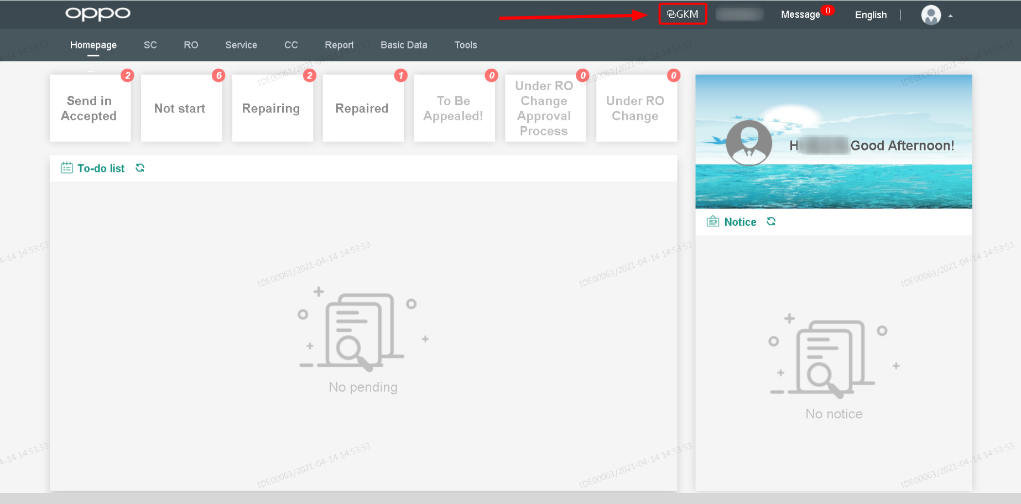
Login GKM with WCSM account
Login method: Login WCSM, jump through the button ‘GKM’ in WCSM system. WCSM：https://service-sg.myoppo.com/login
*Notice: WCSM account is not equaled to GKM account, do not use the WCSM account to login on the login page of GKM.
Please contact WCSM HR Admin, if you don’t have WCSM account.

Slide 8
System Operation
0 2

Slide 9
System Introduction
Homepage
1
Type of Articles
2
Search Bar
3
Content of Article
4

Slide 10
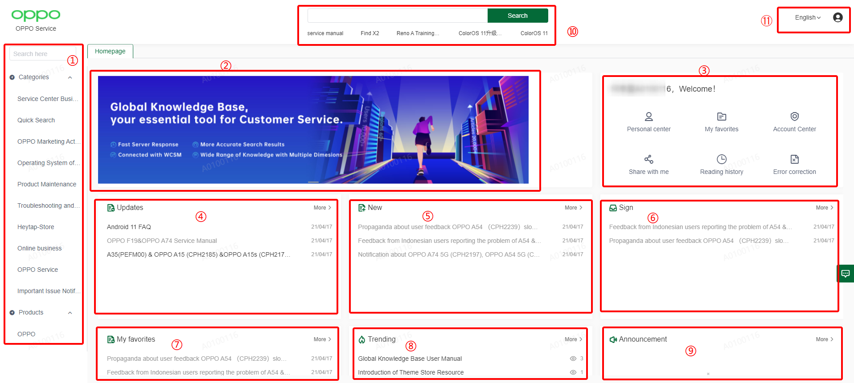
1. Homepage
Homepage
Type of Articles
Search Bar
Content of Article
1. Navigation
2. Banner
3. Personal Center
4. Updated: The latest updated article.
5. New: The latest newly added article.
6. Sign: Articles need to be signed.
7. Favorites: Articles saved as favorites
8. Trending: hottest articles
9. Announcement
10. Search bar
11. Language: Switch user language here.
①
②
③
④
⑤
⑥
⑦
⑧
⑨

Slide 11
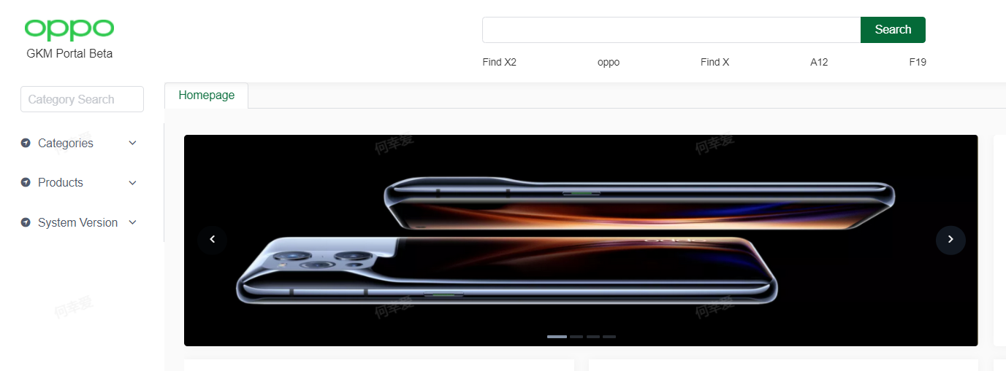
1.1 Navigation
Homepage
Type of Articles
Search Bar
Content of Article
Introduction: The left-side navigation consists of the category search bar and the article category.
Article category: including Categories, Product and System Version.
Category Search Bar: Help to locate the article category below. And fuzzy search is supported.
E.g. Input ‘service’, it will show all the categories containing ‘service’. Click the one you want and open the article list of the chosen category.

Slide 12
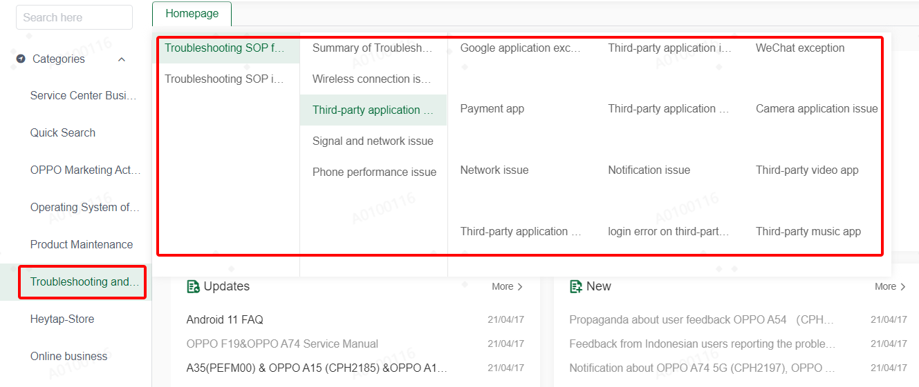

1.2 Navigation
Homepage
Type of Articles
Search Bar
Content of Article
Operation: Hover over category, click on the bottom category
Hover over Category：when you hover over any category, it will unfold all the sub-categories on the right；When hover for about one second, it will display the full name of the targeted category.
Click on the bottom Category：When you click the bottom category, it will open a new page and show all the articles of this category.

Slide 13
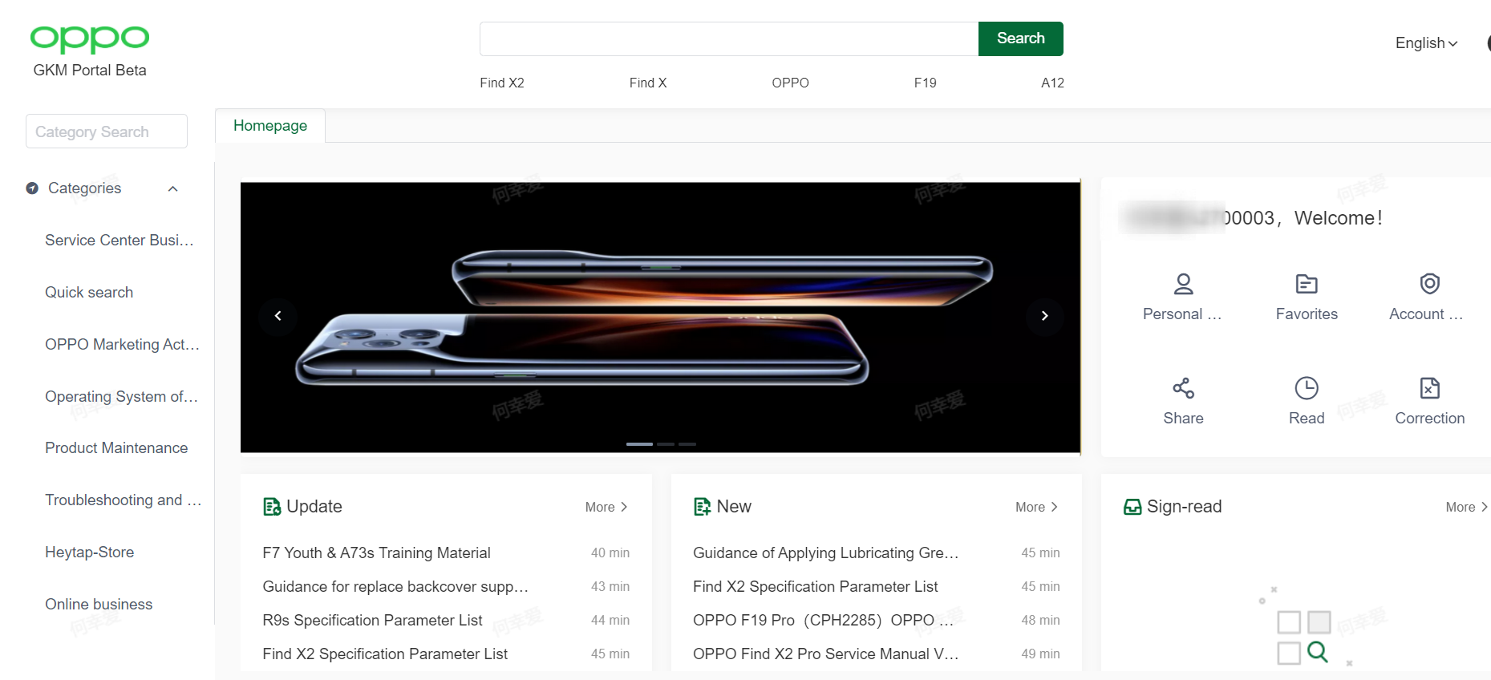
1.3 Banner
Homepage
Type of Articles
Search Bar
Content of Article
Banner: display important news, article or sticky announcement. The maximum displaying amount is eight.
Operation: click and check more details of banner.

Slide 14
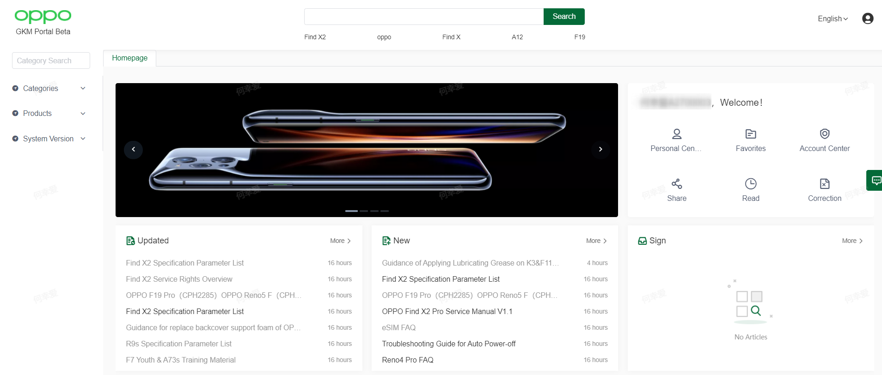
1.4 Personal Center
Homepage
Type of Articles
Search Bar
Content of Article
Including：Personal center，Favorites, Account center, Share, Reading history and Error Correction.
Operation: click and check more details of each icon.

Slide 15
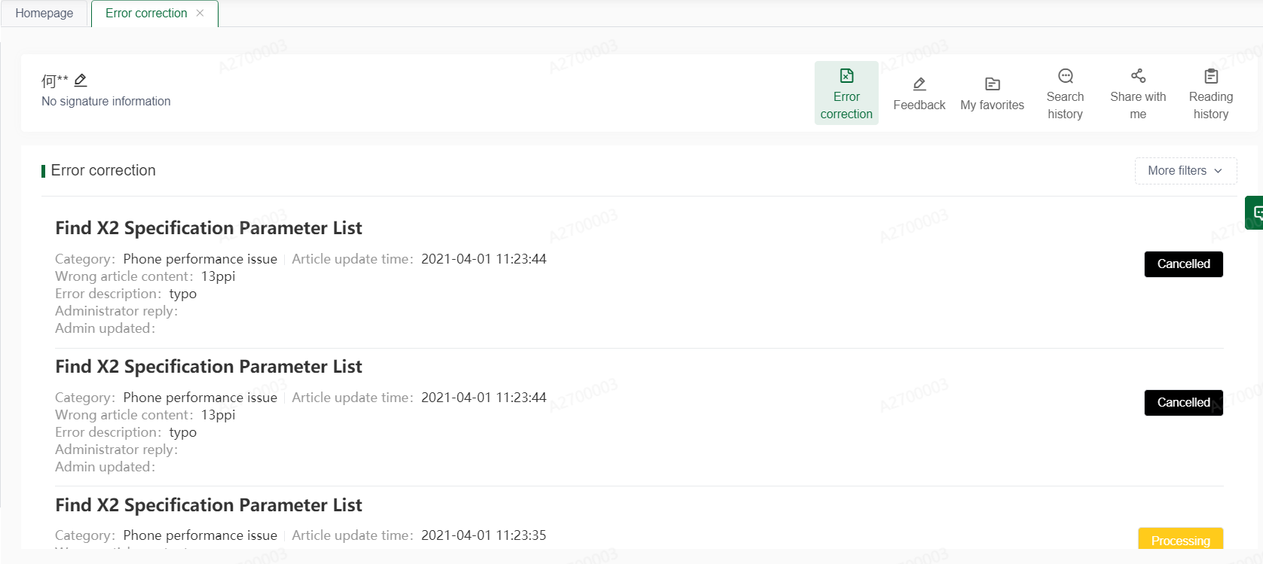
1.4.1 Personal Center
Homepage
Type of Articles
Search Bar
Content of Article
Personal center page: check the records of error correction, feedback, my favorites, search history, share with me and reading history.

Slide 16
1.4.2 Personal Center
Homepage
Type of Articles
Search Bar
Content of Article
Account center: change password or email address.

Slide 17
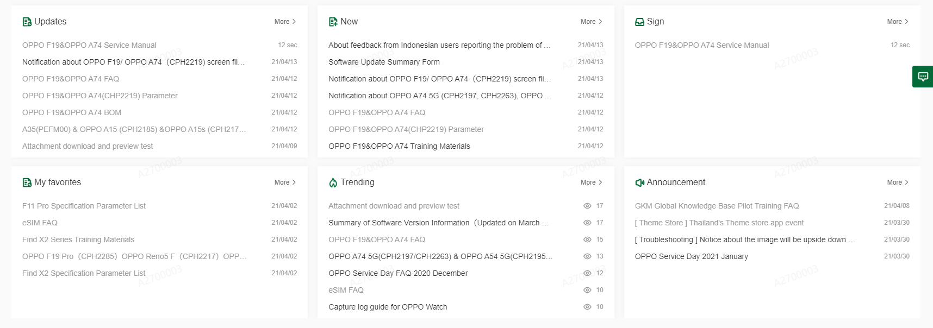
2. Type of Articles
Homepage
Type of Articles
Search Bar
Content of Article
2. New: the newly added article
3. Sign: Articles which need to be well informed and signed.
1. Updates: the latest updated article
4. Favorite: the articles saved as my favorite
5. Trending: the hottest article
6. Announcement

Slide 18
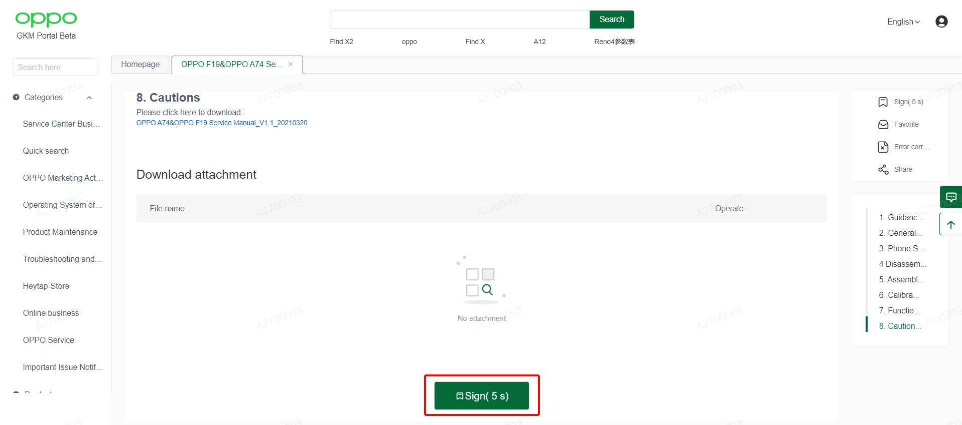
2.1 Sign Article
Homepage
Type of Articles
Search Bar
Content of Article
Operation: click and open the article. After the signing time is over, you can click the sign button on the bottom on the article to finish it.

Slide 19
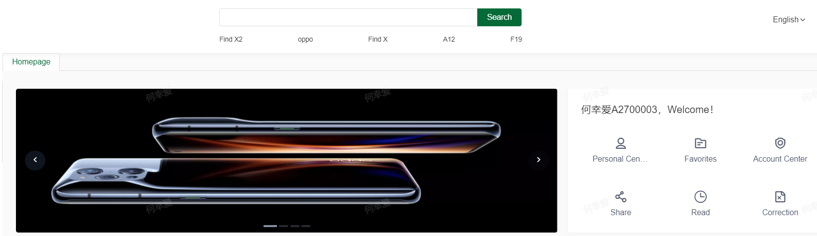
3.1 Search Bar
Homepage
Type of Articles
Search Bar
Content of Article
Hot Search Words: The top 5 most-searched words in the past 7 days.
(counted based on regional searching content and updated every night at 12 o 'clock )

Slide 20
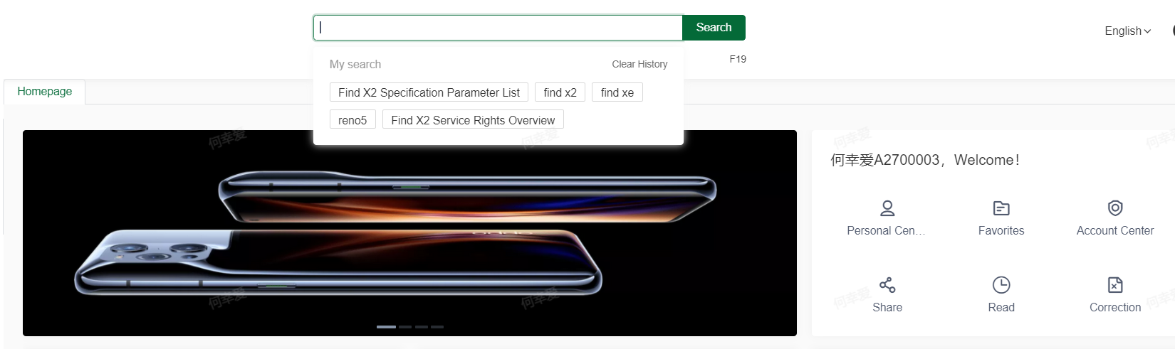
3.2 Search Bar
Homepage
Type of Articles
Search Bar
Content of Article
Search History: when clicked the search bar but not input yet, it will display 10 recently-searched words.

Slide 21
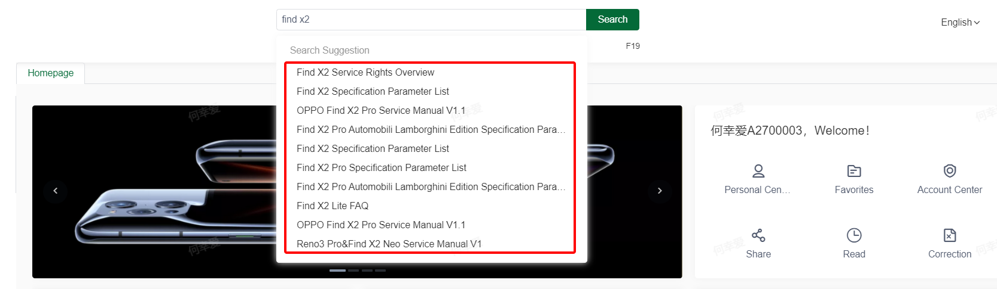
3.3 Search Bar
Homepage
Type of Articles
Search Bar
Content of Article
Search Suggestion: When inputted something, it will display the articles containing the search word. The maximum amount of displaying searching suggestion is 10.

Slide 22
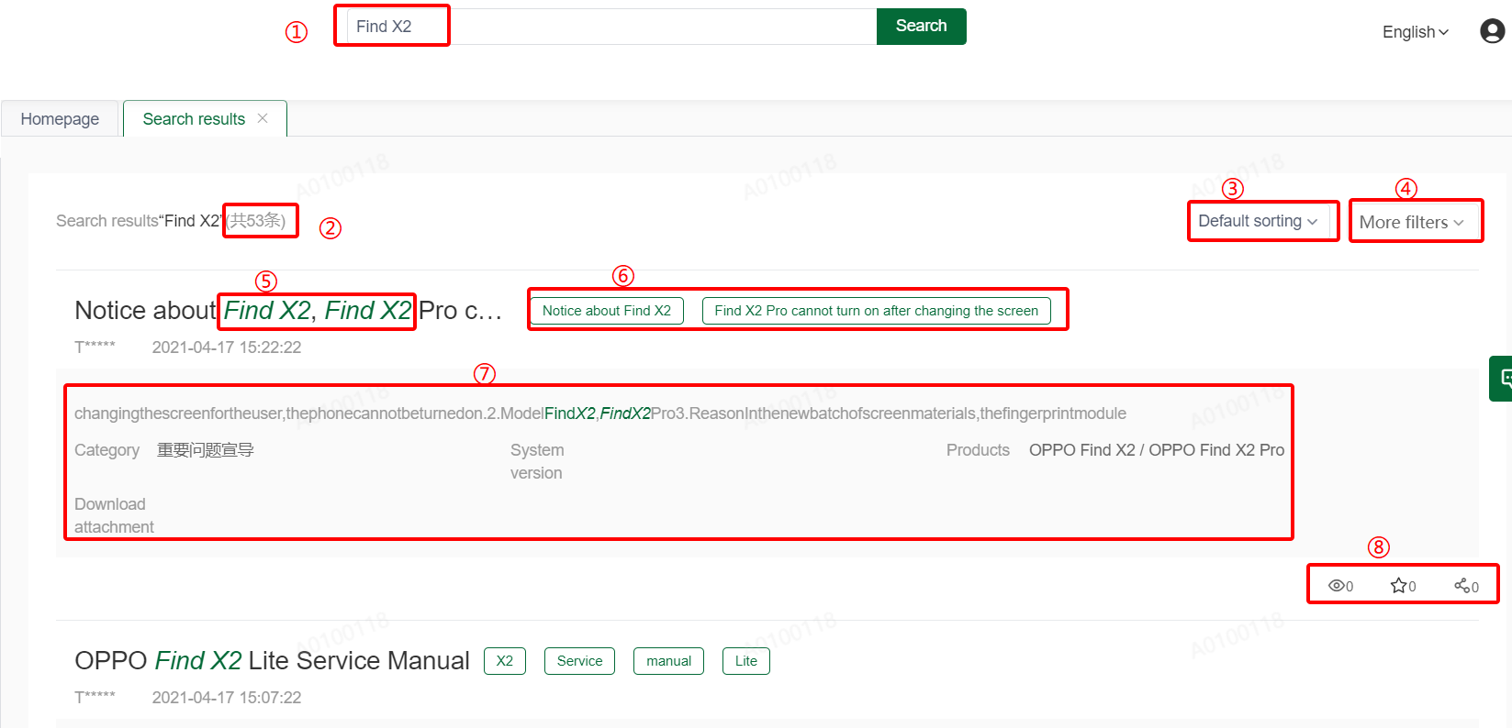
3.4 Search Result
Homepage
Type of Articles
Search Bar
Content of Article
Search Bar：show the current keywords you input
Search results
Default sorting: sort all articles by view amount and search history
4. More filters：Author, Update time, Category, etc.,.
5. Article Title：Fully-matched keywords will be highlighted in green, click the subject to view article content.
6. Keywords：Can be only maintained by the author, fully-matched keywords will be highlighted in green.
7. Article Content/ Abstract：Fully-matched keywords will be highlighted in green.
8. Other Features: View times/ Saved as favorite/ Share

Slide 23
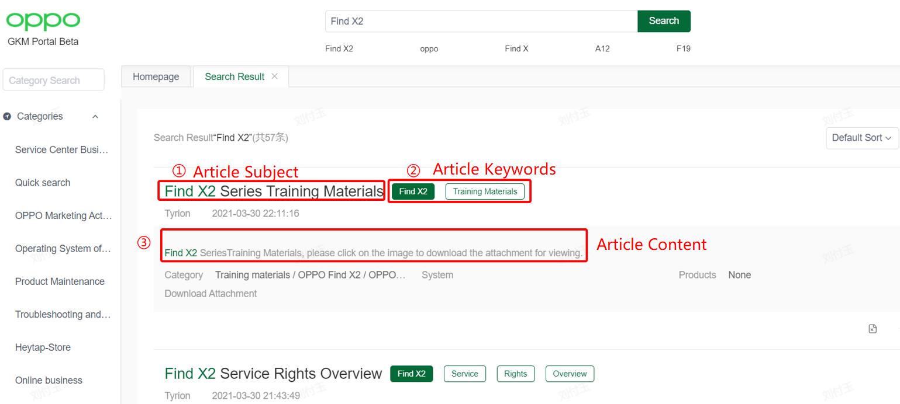
3.5 Search Results Sorting Rules
Homepage
Type of Articles
Search Bar
Content of Article
Basic Rules
Keywords Location: Title> Keywords> Article abstract> Article Content
Keywords’ Repetition: Article with more fully-matched keywords will be sorted at top.
Content length: Content with short length and fully-match keywords will be sorted at top.

Slide 24
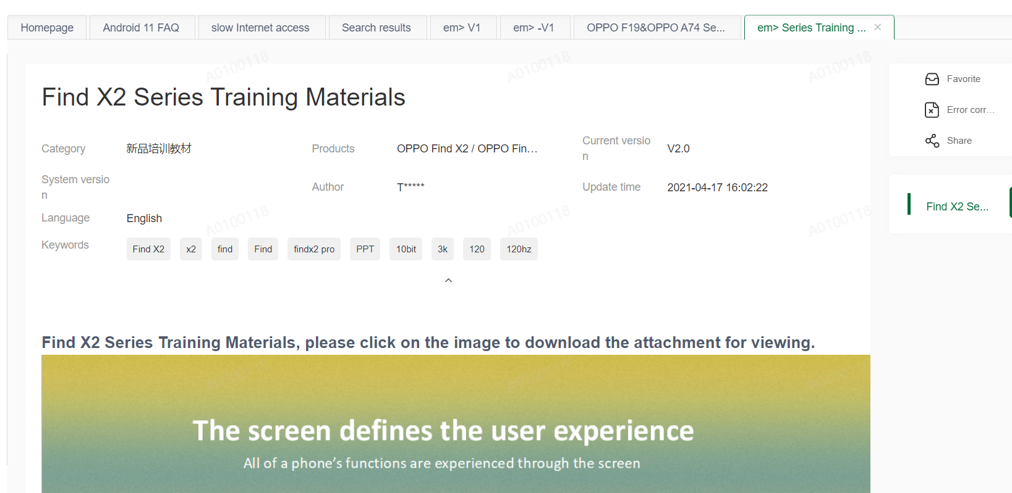
4. Content of Article
Homepage
Type of Articles
Search Bar
Content of Article
Article Subject
Article info
① Category:
② System: Applicable mobile operating system.
③ Language: Applicable languages
④ Keywords: Keywords searched by users but added by the administrator.
⑤Products: Applicable products.
⑥Author: The author of this article.
⑦Version: Current article version.
⑧Update Time
3. Article Content
4. Features
Favorite: Save this article as My Favorite
Error Correction: Click to submit an error correction for this article.
Share：Share this article with GKM users.
5. attachment: article attachment on the bottom

Slide 25
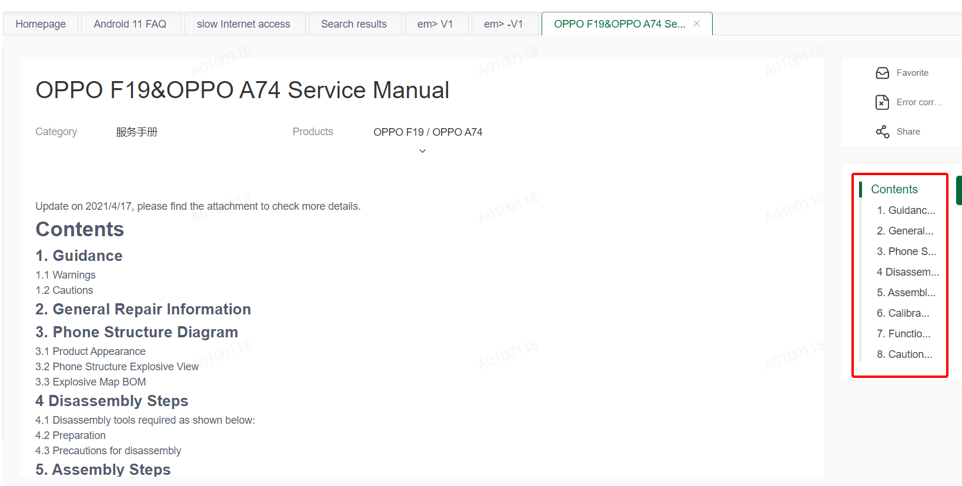
4.1 Article Navigation
Homepage
Type of Articles
Search Bar
Content of Article
Article Navigation: The navigation will be displayed on the right side of the content when the article has too much content with a sub-heading title. Click the navigation will take you to the content you want.

Slide 26
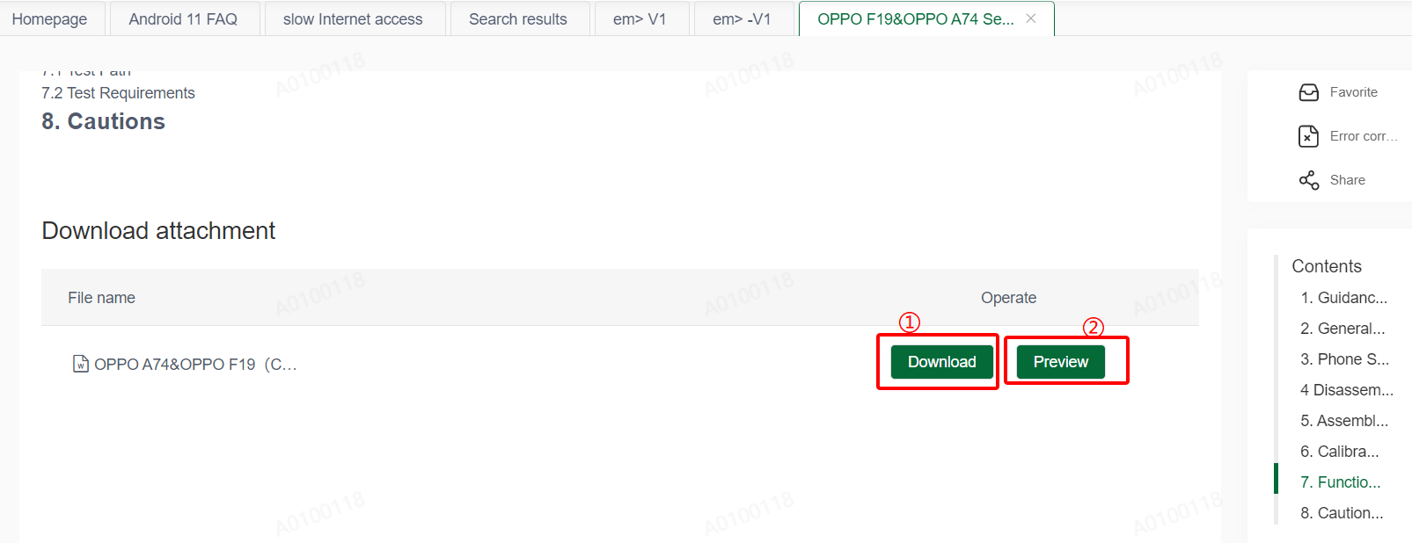
4.2 Article Attachment
Homepage
Type of Articles
Search Bar
Content of Article
Download: Click this button to download the attachment.
Preview: Click this button to preview the attachment online.

Slide 27
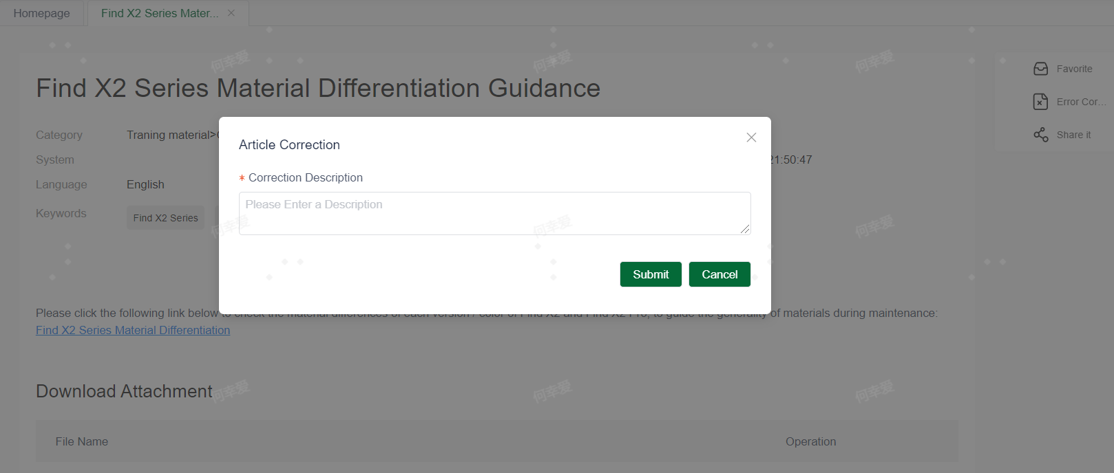
4.3 How to Submit Error Correction
Homepage
Type of Articles
Search Bar
Content of Article
Option 1: Click the Error Correction button, fill the description, and then submit.

Slide 28
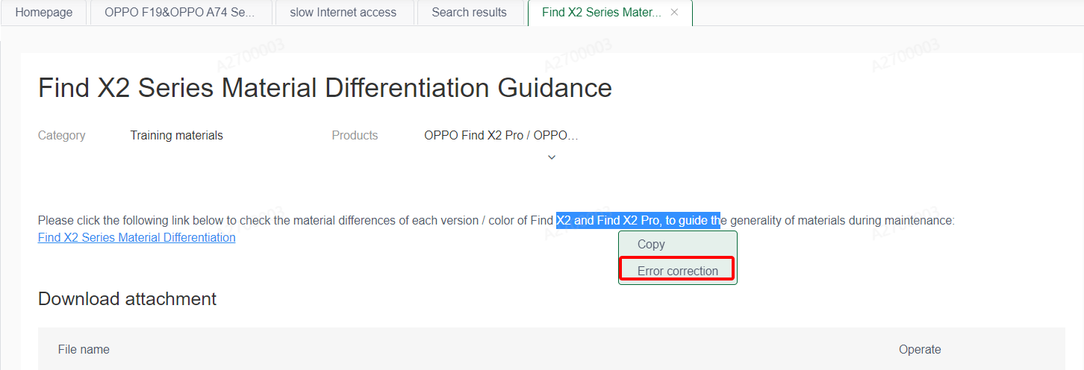
4.3 How to Submit Error Correction
Homepage
Type of Articles
Search Bar
Content of Article
Option 2: Choose the incorrect content and right click the mouse, then choose Error Correction and input the error description on the window prompts on the page.

Slide 29
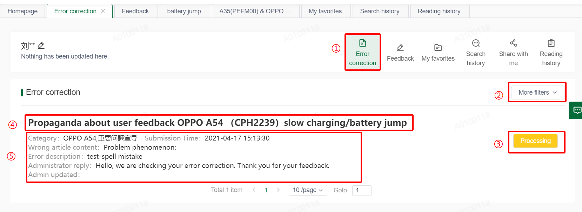
4.3.1 Error Correction Status
Homepage
Type of Articles
Search Bar
Content of Article
1. Error Correction：
Click here to view details of Error Corrections you’ve submitted
2. More filter：
The error corrections will be sorted by the time you submitted, click here to show more filters.
3. Current status
Processing: The admin is processing.
Review: The admin is reviewing
Completed：The error correction is completed
Canceled：Error correction has been withdrew by the submitter or judged by the admin as invalid.
4. Article Titile: click to view more details.
5. Error correction details
Category: Article’s category
Error Correction Content: Incorrect content
Error description：Describe the error.
Admin updated：The article subject will be displayed here when the admin update it.

Slide 30
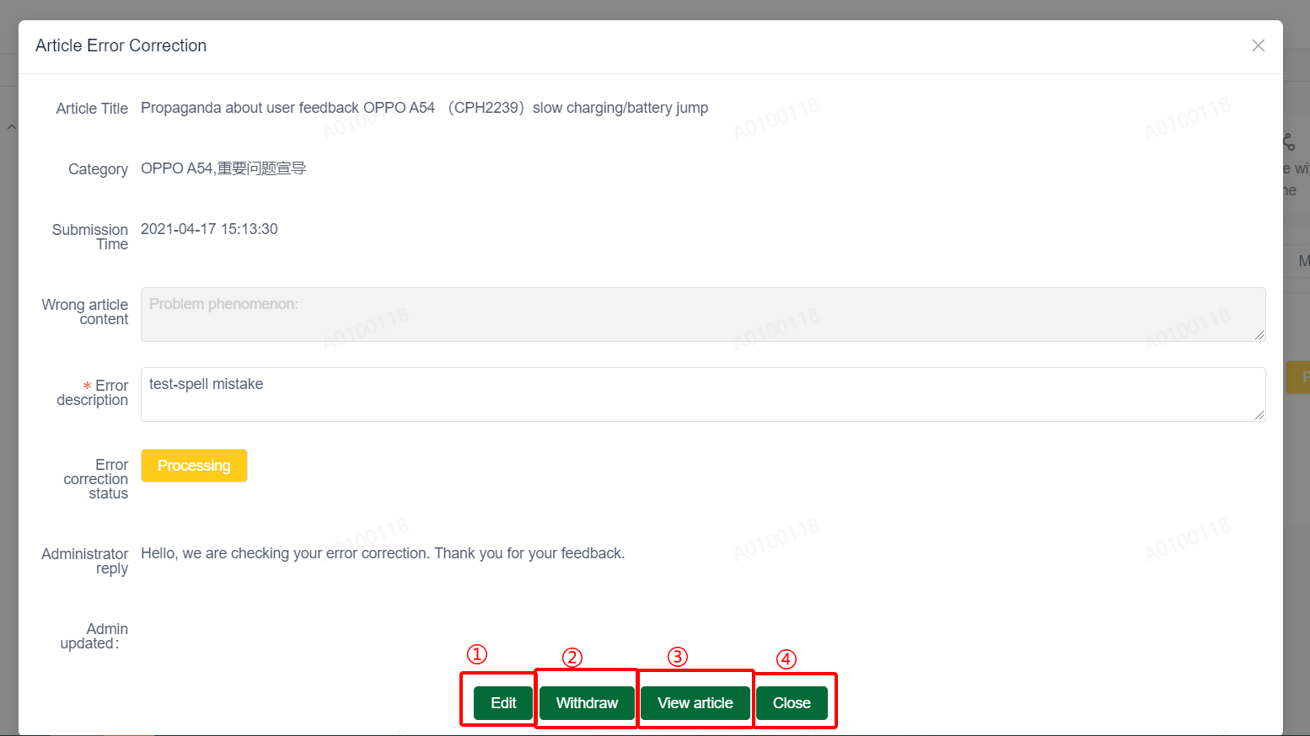
4.3.2 Error Correction Modification
Homepage
Type of Articles
Search Bar
Content of Article
You can update the Error Correction you have submitted by following steps:
Path: Personal Center> Correction> Article Subject
1. Error Correction：
Click here after you change the error correction description
2. Withdraw Error Correction：
Click here to withdraw this error correction, only when the error correction is processing can be withdrew.
3. View article：
Click here to view the article.
4. Close：
Click here to close this window.

Slide 31
Feedback options
0 3

Slide 32

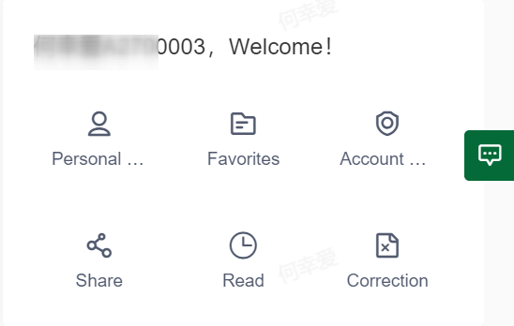
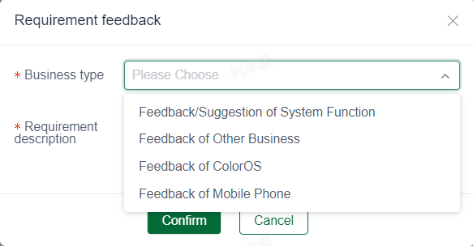
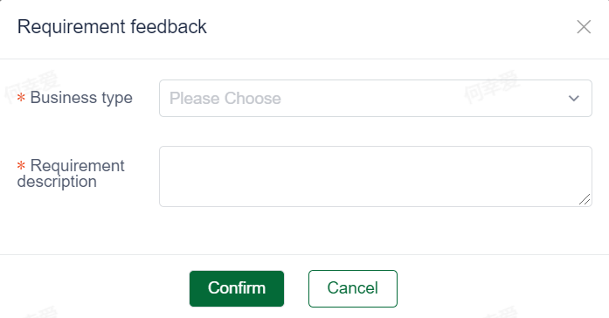
1. Feedback on System
Click this button to submit If you have any suggestions or feedbacks of the system or the contents.
Operation：
1. Business Type: chose the corresponding type based on your feedback
2. Description：give more details of the feedback
3. Click ‘Confirm’ and finish.

Slide 33
2. Feedback to Contact Person (Recommend)
If system problems are found or you have system requirements for us：
Feedback it to your local contact person of knowledge base through the template as attached
If the feedback is not EN/CN, it needs to be translated (for contact person);
Feedback it to the HQ contact person each Wednesday (for contact person).
Notice:
Serious Problems: Feedback it to the HQ contact person by WeChat if you encounter problems like cannot login, cannot search or fail to check the KB.

Slide 34
Questions & Answer
0 4

Slide 35
THANK YOU!
Global Service Center-Knowledge Management Group.
4/28/2021

