Slide 1
How to Promote NPS-
Seize Moment of Truth
2021 Global NPS Promotion & Service Standardization Training
Grace/Ryan

Slide 2
Training Objective
Through 1.5 hour learning，you will：
Knowing of Moment of Truth
Establishing awareness of service touchpoints through “Moment of Truth” in customer service
Discovering driving factors through the user journey map, and analyzing the driving factors finding solutions through the service blueprint

Slide 3
CONTENTS
目录
1
What is “Moment of Truth”
2
How to Find “Moment of Truth”
3
What are the “Moment of Truth" in SC
4
How to Find Solutions

Slide 4
01
What is “MOT”
PART ONE
  1.1 What is MOT
  1.2 What is Peak-low law
  1.3 Significance of MOT

Slide 5
Team Discussion
Question 1
What would you do when you walk in the mall to buy clothes in summer？

Slide 6
Team Discussion
We would…
09
Leave
08
Pick up the clothes
07
Payment（POS/Cash）
06
Decide on purchasing or not
05
Try on the clothes
04
Inquire the color/size
03
Looking for your favorite clothes
02
Walk into the store
01
See the store surface

Slide 7
Team Discussion
Question2
For the above moment of truth, what may affect your shopping experience?

Slide 8
Team Discussion
The factors may be…
09
Leave
Friendly farewell
Well fold,goodlooking packing
08
Pick up the clothes
07
Payment（POS/Cash）
Provide multiple payment methods
Suitable size
Enough time to consider
Hard sales
06
Decide on purchasing or not
05
Try on the clothes
Easy to find the suitable clothes
Provide choice based on your need
Service attitude
Visible price/color/size
Fast respond
04
Inquire the color/size
03
Looking for your favorite clothes
No undue interruption
Friendly reception and provide suggestion
Well-organized display
02
Walk into the store
01
See the store surface
Well-organized/attractive decoration
At any MOT, if the user gets a bad experience, the transaction might be end up (one-time transaction)!

Slide 9
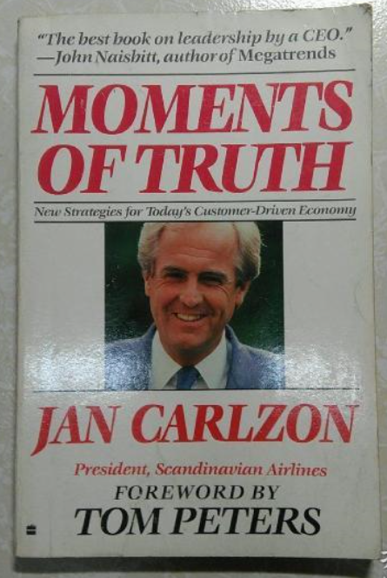
1. What is MOT
Customers only remember those critical moments (Moments of Truth, MOT)
This concept was proposed by Jan Carlson, the former president of Scandinavian Airlines. MOT include:
Call to book a flight;
Arrive at the airport and check your luggage;
Enter the airport and put the ticket on the ticket counter;
Get help from the flight attendants when boarding the plane, and get a farewell when getting off the plane;
……
Carlson defines the "critical moment" in business as follows:
Any time a customer connects with any aspect of a business, no matter how small, it is an opportunity to form an impression.
Carlson redefined Airlines from this: not only a collection of tangible assets, but also a satisfactory contact, one side is a passenger, the other is an employee who directly serves the passenger. In one year, SAS carried a total of 10 million passengers, and each employee contacted 5 passengers for 15 seconds each time. In other words, each of these 10 million passengers "impressed" SAS 5 times a year, each time for 15 seconds, for a total of 50 million times. These 50 million “MOT" determine the success or failure of Scandinavian Airlines.

Slide 10

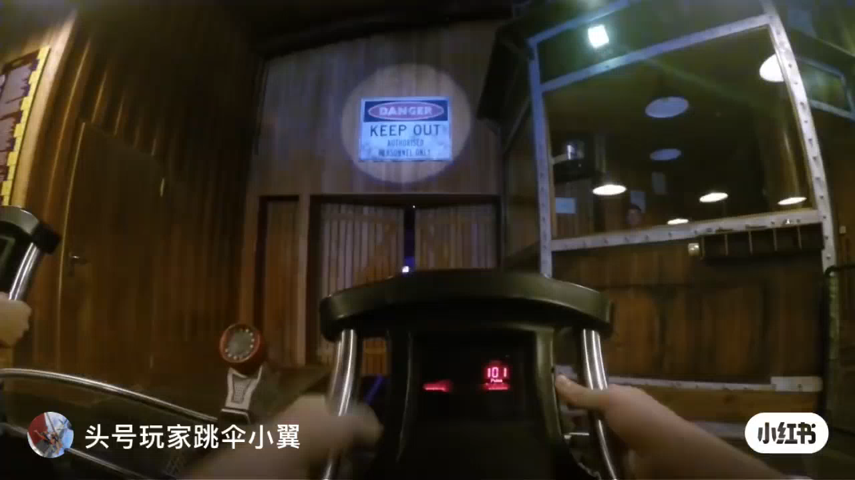

1. What is MOT
1.2 what is Peak-end law
Where is the positive Peak?
End
Theoretical source
Peak-end law: The memory of an experience is determined by two factors: the feeling at the peak (whether positive or negative) and the feeling at the end。
Wait for repairing
Describe issues
Leave
Generate service demand
Go to SC
Find relevant information
Arrive at SC
Get back device
Where is the negative Peak?

Slide 11
1. What is MOT
1.3 Significance of MOT
Customers will only remember the “Moment of Truth", and each interaction may decide whether to continue.
The customer's perception does not depend on the "average score", but on the contact that makes him remember the most
Ensure that customer is satisfied with PEAK and END moment.
Create moments that make customers memorable.
Only if customer pays for the product or service will we have a profit.

Slide 12
Team Discussion
Service Case
Team Discussion
When a customer walked into the SC, the customer had waited for 20 minutes in the rest area until service specialist received him .
Service specialist: Sir/Madam, how may I help you？（ swiping his mobile phone at the same time.)
Customer: My mobile phone screen is broken. Can you help me check how much I should pay for the repair?
Service specialist : (Still swiping his mobile phone) about 800 dollars.
Customer: if so, how long does it take to repair?
Service specialist : The spare part is in shortage now. We need to transfer.
Customer: How long does it take?
Service specialist : (continues to swipe his mobile phone) I'm new staff, I don't know.
Customer: Forget it, I won’t repair my phone here(get up and leave)
Service specialist : (continues to play his phone)
Do you have familiar experience？
If you are the customer, what kind of experience left when you left the SC?
What would you do if you were the service specialist？

Slide 13
02
How to Find “Moment of Truth”
PART TWO
  2.1 What is user journey map
  2.2 How to draw user journey map
  2.3 Practice

Slide 14
2.1 What is User Journey Map
The first step in NPS improvement is to understand the user's complete experience process from the user's perspective, and find out the possible drivers of NPS, and find the direction of improvement of NPS.
"User Journey Map" visually expresses the process of a user or a group to complete a certain goal, depicts the user's behavior and feelings, and assists the company in analyzing key experience scenarios and driving factors, and looking for opportunities.

Slide 15
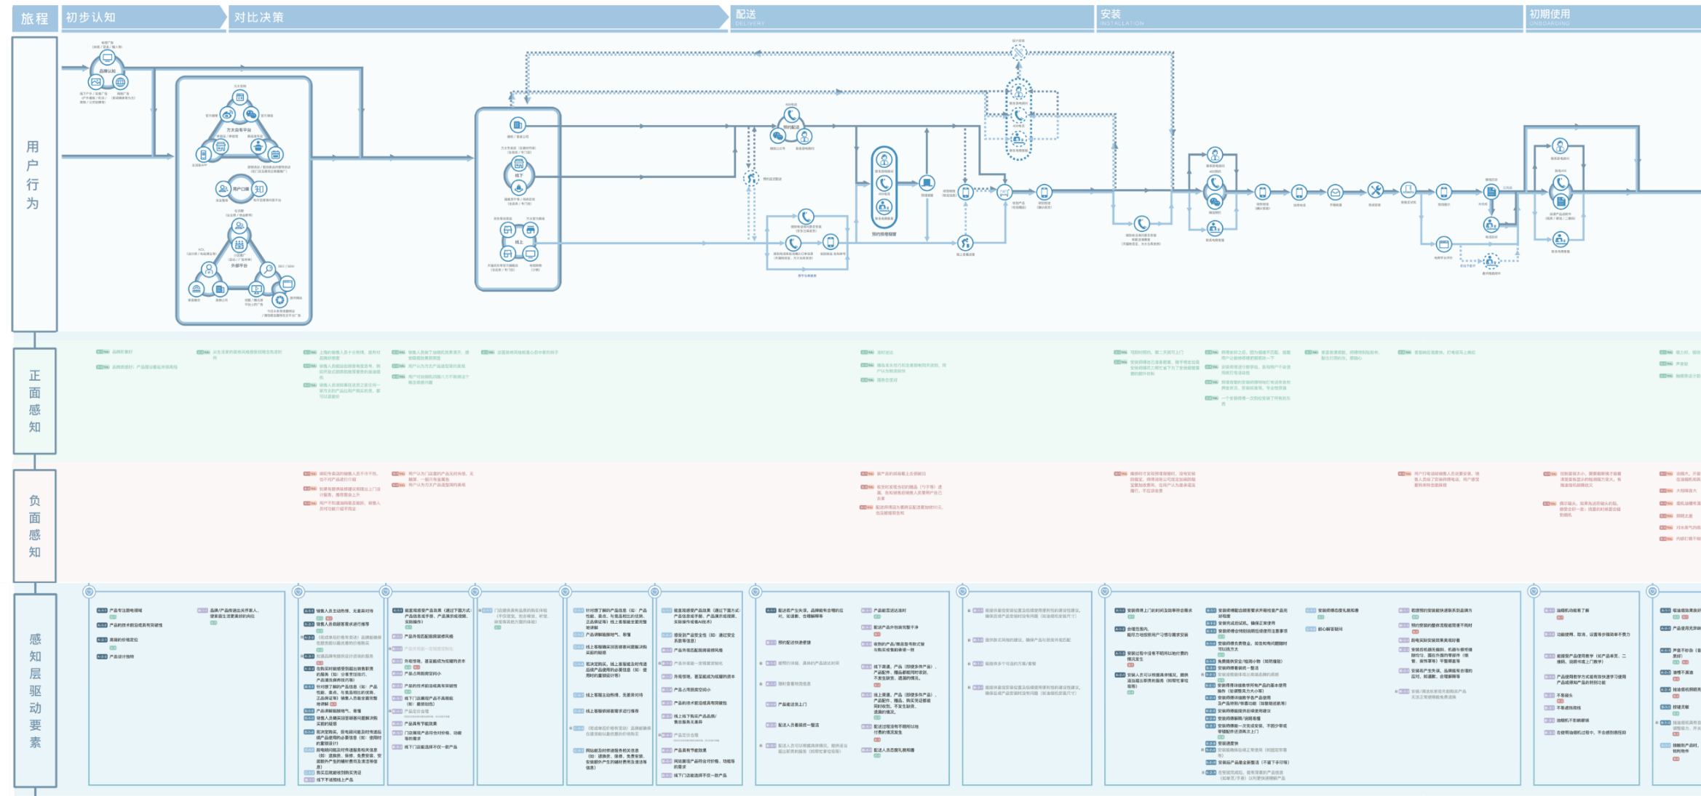
Five Elements of User Journey Map
Example
Elements
Explanations
Cases
Journey stages
Describe the complete user experience process (from purchase to next replacement) based on chronological order
Take the "purchasing" as an example:
Aware of product > compare > experience
> choose the purchase channel > pay
用户行为
01
User behaviors
Visualize the user's behavior in each journey stage, and count the touch points where the behavior occurs (such as physical stores, online official platforms, etc.), and input them into the NPS system monitoring.
Take the "Compare" stage as an example:
offline stores (store environment, sales staff), online platforms (official website, Facebook, Instagram), etc.
02
正面感受
Positive & negative feelings
Describe the user’s most immediate feelings (pain points/surprise points), including good experiences and bad experiences, which is the source of driving factors.
“When I went to the store and listened to the introduction of the salesperson and felt that he/she was not familiar with the advantages of the products.”
03
负面感受
驱动因子
Driving factors
Based on user experience, summarize the "specific" factors that encourage users to have a positive experience, and input them into the NPS system monitoring.
Sales staff can fully explain the information customers want to know (such as product performance, advantages over competing products)
04
05
key issues
Through combing the current situation and experience of each contact point, summarize the core issues of the business department at different stages
Such as "enhancing product awareness"

Slide 16
Example: OPPO Product Journey Map
Before buying
Buying
After buying
01.
Aware of OPPO
Select
Learn more
buy
Get device
Open the box
setting
adapting
Daily use
Receive Shopping guide care
Customer service
Long-term use and repurchase for new
Journey stages
Form brand & product awareness
02.
User behaviors
Visualize the user's behavior in each journey stage, and count the touch points where the behavior occurs (such as physical stores, online official platforms, etc.), and input them into the NPS system monitoring.
03.
Positive & negative feelings
Describe the user’s most immediate feelings (pain points/surprise points), including good experiences and bad experiences, which is the source of driving factors.
04.
Based on user experience, summarize the "specific" factors that encourage users to have a positive experience, and input them into the NPS system monitoring.
Driving factors
Notes:
设计模板自己填

Slide 17
Service Journey Map
Repairing
Users who send for repairing by mailing
Users who send for repairing on site
Users who send for repairing via dealers, salesman or operators
01.
Journey stages
02.
User behaviors
03.
Positive & negative feelings
04.
Driving factors

Slide 18
Example：Service Journey Map
Users who send for repairing on site
01.
Journey stages
1. Find relevant information
······
Leave
02.
User behaviors
1. Find information via hotline, official website, search engine, sales store etc.
1. GOOD: You can quickly find the query entry
2. BAD: Can't find the query entry
2. GOOD: The address information is accurate
2. BAD: The address information is incorrect
3. GOOD: business hours are accurate
3. BAD: the business hours cannot be found or are wrong
4. GOOD: The directions to the store are clear
4. BAD: There is no guide to the shop or there is an error
5. GOOD: The map can accurately locate the store
5. BAD: The map cannot find the store or the positioning deviation is large
6. GOOD: There is phone information and can be connected
6. BAD: Can't find the phone or get through
03.
Positive & negative feelings
04.
1.Convenient to inquire the official after-sales information
2. The address information is accurate and easy to understand
3. Accurate business hours
4. The instructions to the store are clear and accurate
5. Accurate map positioning
6. Phone information is accurate
Driving factors
Notes:
设计模板自己填

Slide 19
Follow Board
Service Journey Map | Customer Service
Journey Stages | 1. Find Relevant Information
User Behaviors
Positive & negative feelings
Driving Factors

Slide 20

Teamwork：Let’s draw an Service Journey Map together!
Task：Take users who send for repairing on site as an example, and describe journey stages
01.
Journey stages
Thinking for 2 min individually
Group discussion for 5 min
Making a conclusion for 3 min
02.
User behaviors
Take a small group as a unit. Each person takes turns to share their own ideas, and other people make supplements
Please write down your thoughts with reference to "User Journey Map Elements and Explanations"
One person summarizes the results of the discussion and fills in the form
03.
Positive & negative feelings
04.
Driving factors
If you have questions, please contact us in time
Notes:
做一个寄修的模板

Slide 21
Teamwork：Let’s draw an Service Journey Map together!
Task：Take users who send for repairing on site as an example, and describe user behaviors
01.
Journey stages
Thinking for 2 min individually
Group discussion for 5 min
Making a conclusion for 3 min
02.
User behaviors
Take a small group as a unit. Each person takes turns to share their own ideas, and other people make supplements
Please write down your thoughts with reference to "User Journey Map Elements and Explanations"
One person summarizes the results of the discussion and fills in the form
03.
Positive & negative feelings
04.
Driving factors
If you have questions, please contact us in time

Slide 22
Teamwork：Let’s draw an Service Journey Map together!
Task：Take users who send for repairing on site as an example, and describe positive & negative feelings
01.
Journey stages
Thinking for 2 min individually
Group discussion for 5 min
Making a conclusion for 3 min
02.
User behaviors
Take a small group as a unit. Each person takes turns to share their own ideas, and other people make supplements
Please write down your thoughts with reference to "User Journey Map Elements and Explanations"
One person summarizes the results of the discussion and fills in the form
03.
Positive & negative feelings
04.
Driving factors
If you have questions, please contact us in time

Slide 23
Teamwork：Let’s draw an Service Journey Map together!
Task：Take users who send for repairing on site as an example, and draw user journey map
01.
Journey stages
Sharing for 10 min
02.
User behaviors
Recommend representatives to share, and sharing screen
03.
Positive & negative feelings
04.
Driving factors
Notes:
设计模板自己填

Slide 24
03
What are the “Moment of Truth" in SC
PART THREE
  3.1 Service Journey Map

Slide 25


3.1 Service Journey Map
Journey
stages
1. Find relevant information
2. Go to SC
3. Arrive at SC
4. Describe issues
5. Wait for repairing
6. Get back device
7. Leave
8. Receive a survey
User behaviors
1. Find information via hotline, official website, search engine, etc.
2. Go to SC (choose one of transportation, check the environment, find a parking area, etc.)
3. Find SC(through address, entrance sign, telephone consultation)
1. Generate the first impression of the store environment on arrival
2. Percept and evaluate reception service
-Say hello
-Guidance
-Pick up and wait
-Waiting for care
-In-store experience (item)
1. Describe issues
-Phone reception
-Problem diagnosis
-Initial fault detection
-Issuing documents
2. Sign name
1. Wait for Repairing
2. Confirm maintenance requirements (causes of failure, treatment methods, maintenance quotation, risk description)
1. Ask the reason and result of the question
2. Take the machine and check
-- Demo
-- Diagnose report
-Demand reconfirmation
-Precautions for us
_ 3. Pay
1. Leave the store
2. Accept the return visit and care
--Farewell to the user
Positive & negative feelings
③
⑤
⑥
②
④
①
1. Offline service channels are not publicized properly and resources are few
2. The official website search has bugs
3. The SC staff spoke too fast on the phone
4. Public transportation is undeveloped and crowded, 5.parking area are difficult to find
1. The main shortage of the store environment is the sense of space. The small space does not provide a sofa for waiting to rest, and the environment is not clean enough.
2. Staff service awareness is relatively weak, no initiative to greet, provide guidance
1. the problem handling ability is bad
2.communication skill is not good
3. service attitude is bad
4. Not professional, or not effective
1. The problem handling is not ideal, the cause is missing and the solution is not clear, and the communication skills and details of the personnel service process also expose the lack of professionalism
2. Lack of service awareness, not active
3. Unfriendly service attitude
4. Do not inform me to take the phone in time
1. Lack of Notice of follow-up use, poor performance
2.The user ’s experience before leaving the store is incomplete
3. Data lost
4. There are new problems
5. Inconvenient to pay
6. The cost is too high
1. SC staff ignore me
2. call center staff’s attitude is not good. 3.return rate of the OPPO customer service center is lower than the user's expectations
Driving factors
1.Convenient to inquire the official after-sales information
2. The address information is accurate and easy to understand
3. Accurate business hours
4. The instructions to the store are clear and accurate
5. Accurate map positioning
6. Phone information is accurate and effective
7. The official logo is clear
1. The environment is comfortable and clean
2. There will be service staff to receive on site
3. Good attitude of service staff
4. Short queue time on site
1. Strong diagnosis and investigation ability
2. Strong communication skills
3. Good service attitude
1. Effectively solve the problem
2. Fast repair/return and exchange
1. Clearly inform the failure problem
2. Inform the precautions for use
3. Provide service report
4. The repair price is transparent and reasonable
1. Good attitude of service staff
2. Feel the caring service

Slide 26
04
How to Find solutions
PART FOUR
  4.1 Sort out Journey Stages and User Behaviors
  4.2 Find out Key Issues
  4.3 Identify Key Actions and Resources
  4.4 Case Study

Slide 27
How to Find Solutions（1/3）——Sort out Journey Stages and User Behaviors
Customer Service
Journey Stages
1. Find relevant information
2. Go to SC
3. Arrive at SC
4. Describe issues
5. Wait for repairing
6. Get back device
7. Leave
User Behaviors
Step1: Get user journey stages and user behaviors from the user journey map

Slide 28
How to Find Solutions（2/3）——Find out Key Issues
Customer Service
Journey Stages
1. Find relevant information
2. Go to SC
3. Arrive at SC
4. Describe issues
5. Wait for repairing
6. Get back device
7. Leave
User Behaviors
Key Issue
（?）
Step3: Based on user needs, developing an ideal service experience
Step2: In response to user needs, locating the issues that need to be improved

Slide 29
How to Find Solutions（3/3）——Identify Key Actions and Resources
Customer Service
Journey Stages
1. Find relevant information
2. Go to SC
3. Arrive at SC
5. Wait for repairing
6. Get back device
7. Leave
4. Describe issues
User Behaviors
Key Issue
(?)
Actions
Identifying the actions required
Support
Identifying the internal resources required
Step4: For the ideal service experience, clarify the actions that need to be taken and the internal resources needed

Slide 30
Case——Improve the easy-to-find-SC
Customer Service
Journey Stages
1. Find relevant information
2. Go to SC
3. Arrive at SC
5. Wait for repairing
6. Get back device
7. Leave
4. Describe issues
User Behaviors
1. Find information via hotline, official website, search engine, etc.
2. Go to SC (transportation, environment, parking, facilities, etc.)
3. Find SC(address, entrance sign, telephone consultation)
Key Issue
Improve the easy-to-find-SC
My OPPO/Official website can provide the nearest SC, and have route navigation
After obtaining the store address, users can find the OPPO official SC accurately and conveniently
Google Map can provide accurate official website information and guide you to the store
Users can quickly identify whether it is an official customer service center
Actions
1. Third-party Map: timely update official maintenance information
2. Search Engine: perfect keyword search and put official information on top
1. Improve relevant guidance information on third-party platforms, inform users of relevant travel information, and guide users to the store
2. Increase the logo outside: the service center logo is obvious, and different from the private repair store
Support
1. Distributors: unified training for first-line response skills; shopping guides publicize the OPPO service information before sales; update SC information and guide pictures in time, and report changes to the HQ in time
2. IT support: make interactive design on official website/official APP : SC information query is increased and the query entry path is simplified
Notes:
动画

Slide 31
Follow Board
Customer Service
Journey Stages
1. Find relevant information
5. Wait for repairing
7. Leave
2. Go to SC
3. Arrive at SC
4. Describe issues
6. Get back device
User Behaviors
1. Find relevant information
2. Go to SC
3. Arrive at SC
4.Describe issues
5.Wait for repairing
6.Get back device
7. Leave
8. Receive a survey
Key Issue (?)
1. Find relevant information
2. Go to SC
3. Arrive at SC
4.Describe issues
5.Wait for repairing
6.Get back device
7. Leave
8. Receive a survey
Actions
Support
Internal
Distributors
Other departments
IT Support
Assessment incentives

Slide 32
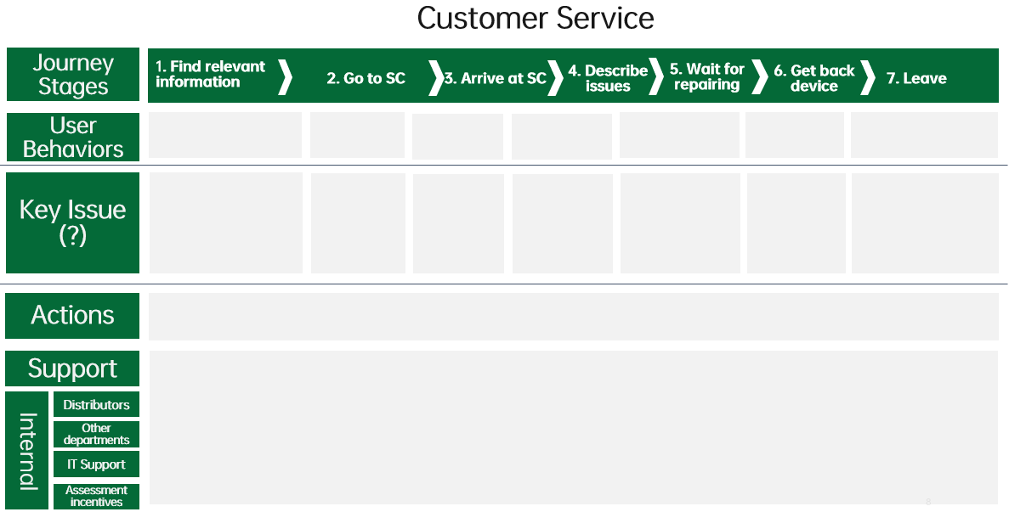
Teamwork：Let’s find a service solution together
Please select A key improvement issue based on your work experience, and seek a service solution, and finally fill it in the following table.

Slide 33
Conclusion
MOT：The customer‘s perception of the company does not depend on the “average score”, but on the contact that makes him remember the most. Ensure that customer is satisfied with every MOT.
2. How to draw user journey map：
Identify journey stages
Describe user behaviors
Describe positive & negative feelings
Find out driving factors
Identify Key issues
3. How to find solutions：
Sort out journey stages and user behaviors
Find out key issues:
locating the issues that need to be improved; developing an ideal service experience
Identify key actions and resources:
Identifying the actions required and the internal resources required

Slide 34
Thanks
Keep Standard in Mind Strive for Better Service

