Slide 1
What is NPS--
Forging User-centered Value Concept
2021 Global NPS Promotion & Service Standardization Training
Ryan

Slide 2
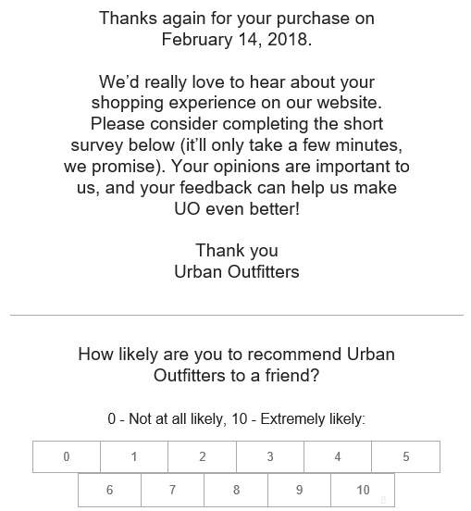
Have you ever heard NPS or received an E-mail like this?

Slide 3
Training goal
Through one-hour learning, you will get:
Through the introduction of NPS theory, re-recognizing the "user experience" and promote a user-centric service concept;
By learning the new concepts of NPS, promoting the recognition of NPS application value by all employees, and form the NPS cultural atmosphere

Slide 4
CONTENTS
目录
1
Introduction of NPS
2
Interpretation of New Concepts

Slide 5
01
introduction of NPS
PART ONE
  1.1 Background– Experience Economy
  1.2 What is User Experience
  1.3 How to Measure User Experience
  1.4 Why NPS

Slide 6
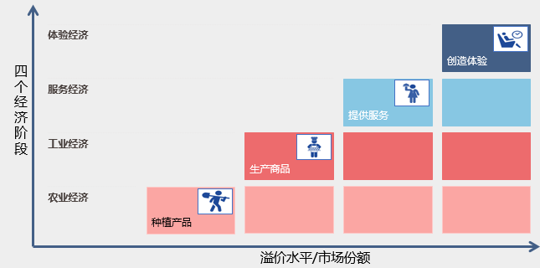
1.1 Background—Experience Economy
Creating Experience
Experience Economy
We are now in the age of Experience Economy ！
Service Economy
Providing service
Industrial Economy
Making a product
Agricultural
Economy
Planting and Harvesting
market share
As the Harvard Business Review so eloquently put it—"a company intentionally uses services as the stage, and goods as props, to engage individual customers in a way that creates a memorable event.“
The goods are tangible, the service is intangible, and the experience created is unforgettable.“

Slide 7
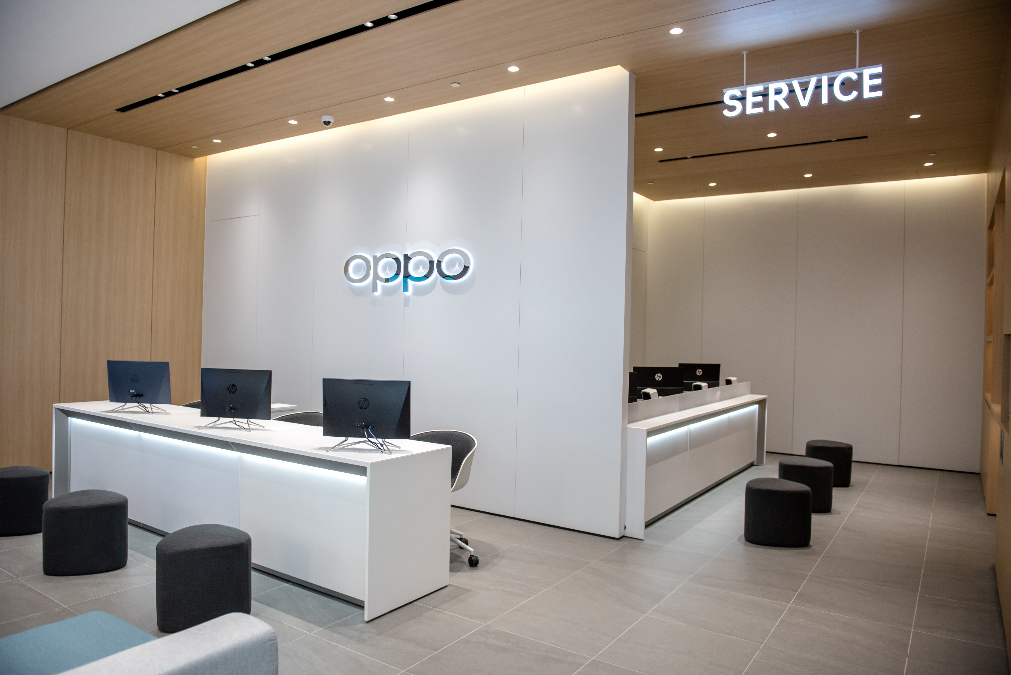
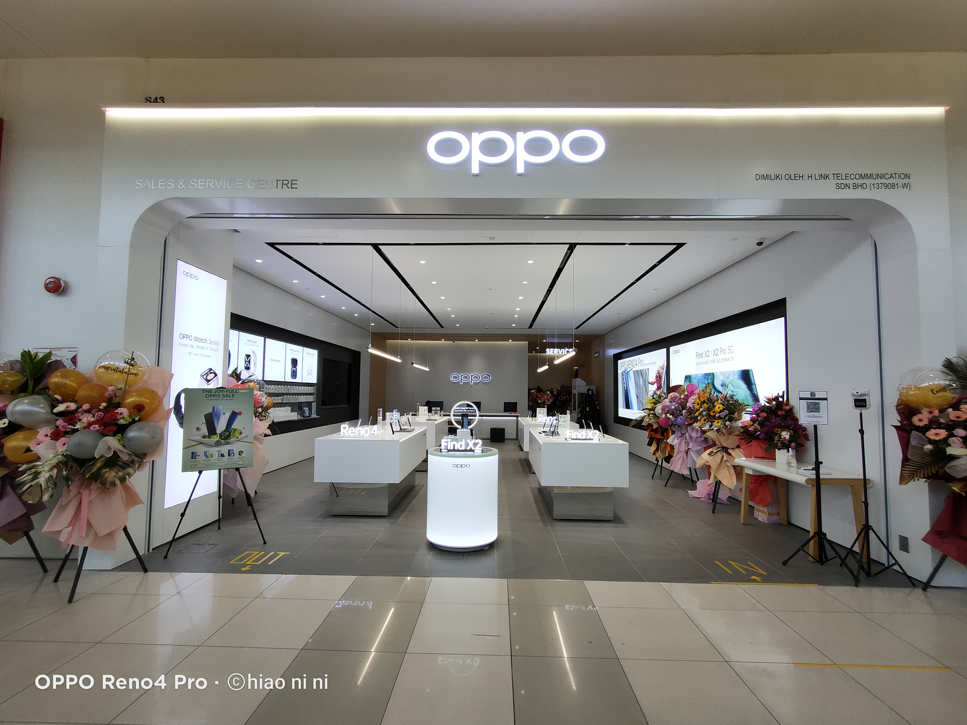
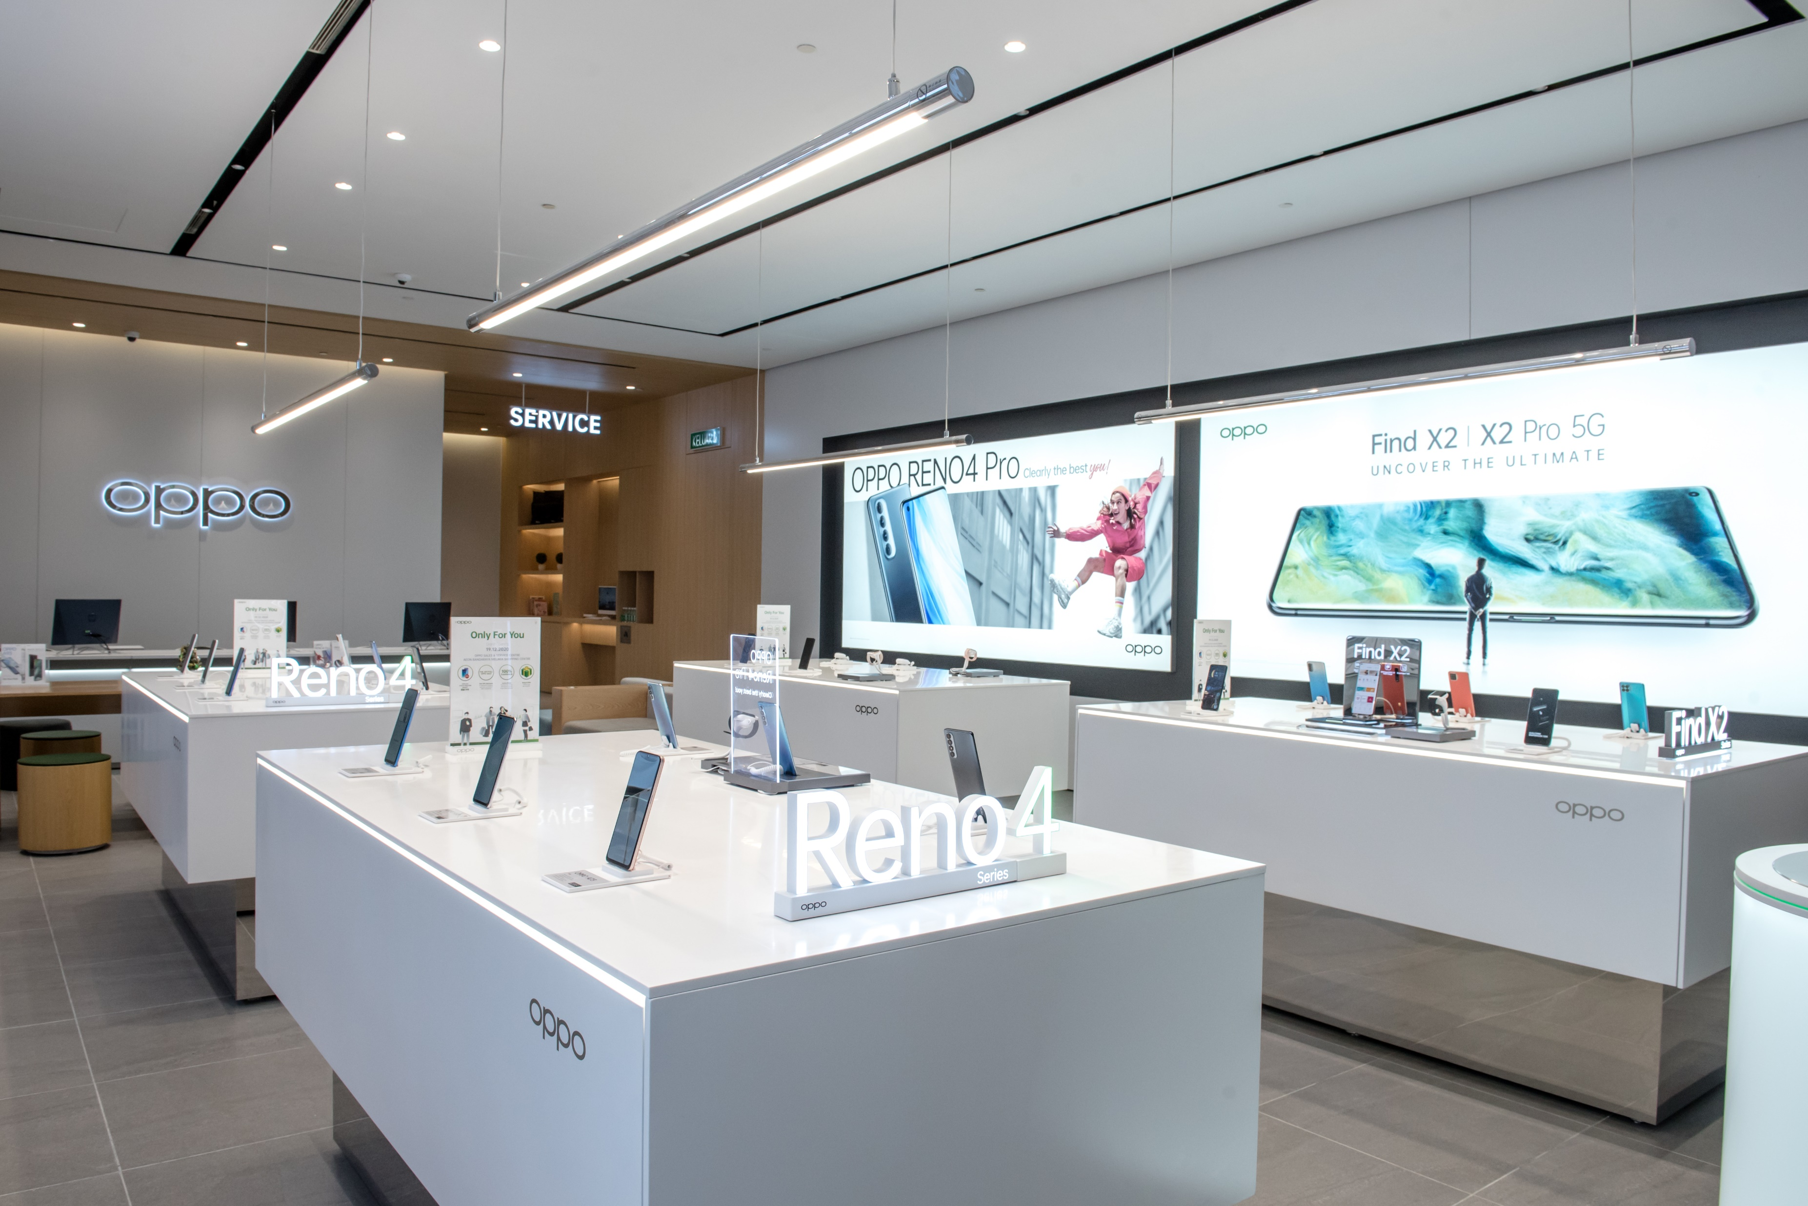
1.1 Background—Experience Economy
How does it affect our work?
Service Center
OPPO Store
Sales & Service center

Slide 8
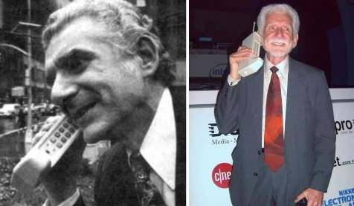
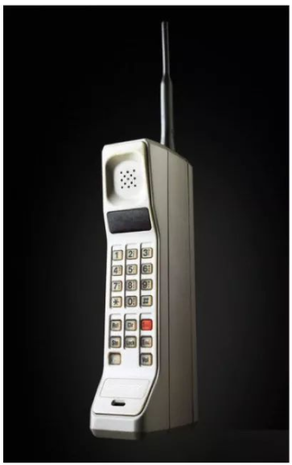
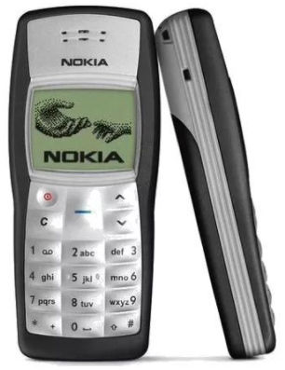
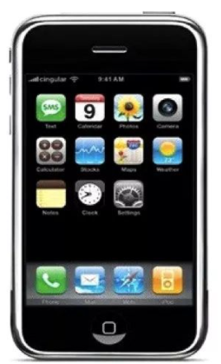
1.1 Background——Experience Economy
Functional experience
Performance experience
Interactive performance
Brand Loyalty
In June 1983, Motorola launched the Dyna TAC 8000X with half an hour of talk time, priced at 3,995 US dollars.
In October 2003, Nokia 1100, the best-selling mobile phone in history, met most people's needs with stability, simplicity, and low price.
In 2007, Apple launched the iPhone. The experience it brought was revolutionary. Its appearance overturned the entire mobile phone market, and mobile phones entered a new era.
On April 3, 1973, former Motorola executive Martin Cooper opened the first mobile phone in history. It weighs about 1.13 kg and can talk for ten minutes in total.

Slide 9






1.1 Background——Experience Economy
Loyalty&
Acknowledgement
v
Brand Loyalty
Under such circumstance
By shaping the Sense Experience and Brand Loyalty from the perspective of scenes of daily life, we need to capture the attention of customers, and change their consumption behavior so as to find new value and space for our products, which finally allow the company to win more market share and benefits.
Emotional
Experience
Interactive Experience
Performance
Experience
Functional Experience
Sense experience

Slide 10
1.2 What is User Experience
v
Experience Journey
Under such circumstance
Aware
Ask
Act
Use
Feedback
Contact points of product should be divided by the user's entire experience journey, and each stage has corresponding touch points.
Experience perception is a continuous state that users have gradually accumulated in previous contact-points, and is an emotional appeal formed after long-term participation.
The improvement of experience needs to be broken down into the improvement of user experience of each contact point.
Marketing, Ads,
By word of mouth
Offline/Online stores,
Other media
Reservation,
Purchasing,
Registration
Functional performance,
Content,
Interactive
Customer service,
Complaint,
Return &exchange
User experience
Satisfied
Expectation
interval
Satisfied
Feeling line
Unsatisfied
Contact-point 1
Contact-point 2
Ending
Experience Journey

Slide 11
1.3 How to Measure User Experience
v
“If you cannot measure it, you cannot manage it”
——Peter Drucker
The essence of experience indicators is Experience Management

Slide 12
1.3 How to Measure User Experience
The pros and cons of common user experience indicators
Subjective indicators
Customer service indicators
Operational/behavioral indicators
CSAT, Customer Satisfaction
Return Rate
Active user
CES, Customer Effort Score
Maintenance Rate
Retention Rate
NPS, Net Promoter Score
Received Negative Feedback Rate
Time on Page
…
…
…
Pros: reflecting the user's subjective real experience
Cons：A. Cost of collecting data；
B. high requirements of survey design, sample collection and data quality
Pros：simple to monitor
Cons：The range of users covered and the types of problems exposed are limited, and cannot reflect the real user experience
Pros：Objective record of users' actual usage behavior
Cons：A. Data is easily manipulated；B. Difficult to explain the reasons behind the numbers （why）
In practice, a good user experience indicator system often needs to integrate user subjective evaluation indicators and objective operational indicators.

Slide 13

1.3 How to Measure User Experience
NPS is short for Net Promoter Score, “How likely are you to recommend our product/service to a friend or colleague? 0-Not at all likely，10-Extremely likely “
A representative indicator used by many well-known companies to measure user experience and reputation
How likely are you to recommend our product/service to a friend or colleague? 0-Not at all likely，10-Extremely likely
0 | 1 | 2 | 3 | 4 | 5 | 6 | 7 | 8 | 9 | 10
Detractors
Passives
Promoters
NPS
＝
Promoters%
﹣
Detractors%

Slide 14
1.4 Why NPS
CSI/CSAT 用户满意度
NPS 净推荐值
优点：满意度的提问方式，适用场景广泛
缺点：
用户满意与用户的真实行为之间关联性较弱。即使用户有高满意度也有可能不会继续购买产品或续签服务。
满意度的计算方式相比NPS，不容易放大差距，可能会导致企业忽视一些问题
Pros：
Applicable to many business
Cons:
Users who are highly satisfied may not continue to purchase products
Cannot identify different types of users, and some problems are easily ignored.
优点：
简答、易答，便于企业快速识别不同类型的用户；
相比满意度仅是对过去发生的事情进行评价NPS更为直接的指向用户未来的行为；
向他人推荐需要自己的信用背书，更具挑战性。
缺点：有的场景/产品并不适合“推荐”给别人。
Pros：
Simple to answer, convenient to quickly identify different types of users ；
NPS more directly reflects the future behavior of users ；
Requiring the endorsement of the user’s own credit, which is more challenging 。
Cons：
Some not suitable for recommendation
In practice, it is difficult to directly improve NPS. So strategic NPS combined with customer satisfaction in various business(contact points) is often used to improve the overall NPS.

Slide 15
1.4 Why NPS
Question
Monitoring
Target
Strategic NPS
您有多大可能性把我们OPPO产品/品牌推荐给您的朋友或同事？ 0分表示非常不可能，10分表示非常可能。
How likely are you to recommend our product/brand to a friend or colleague?
0-Not at all likely，10-Extremely likely
解决公司及业务系统的方向问题
Solving the direction problem of the company and business
外部第三方调查
Third party investigation
check
support
Service
NPS
您对本次维修过程的满意程度如何？请根据您的满意程度打分。从1-10分，1分表示“非常不满意”，10分表示“非常满意”。
How satisfied are you with this after-sales service? Based on your experience, please rate from 1 to 10 points. 1-Very Dissatified,10-Very Satisfied
第三方调查
内部日常监测
Third party investigation
And internal monitoring
解决具体业务的改善问题
Solving specific business issues

Slide 16
1.4 Why NPS
Higher sum of business turnover
Better market performance(total revenue)
Lower employee turnover
From the perspective of users’ Life Time Value, companies with high scores and companies with low scores will have a 140% difference in company business turnover.
Companies that are good at user experience outperform the overall stock market, with an average return of three times that of the S&P 500
The turnover rate of an ordinary company is about 12%, but when a company cares more about the customer experience and effectively increases the NPS value, the employee turnover rate also drops rapidly

Slide 17





1.4 Why NPS
In the mobile phone industry, Apple, Samsung, and Huawei introduced NPS earlier and have had mature operations
Samsung：Introduced in 2012, starting from regional market and retail, gradually covering product design and experience, services, user operations
OPPO: At the end of 2019, product NPS began to operate systematically, and branding, marketing, retail, and service began to be introduced in 2020
Apple：Introduced in 2007, starting from retail stores, gradually covering marketing, sales, product use and services, as well as eNPS, focusing on user lifetime value
Huawei：In 2014, we started from the overall research, driving the improvement of products and user experience. Now it has covered multiple parts such as products, retail, and services. KPI
Xiaomi： NPS was firstly introduced to the PC product in 2019, and gradually to mobile phones in 2020

Slide 18
02
Interpretation of New Concepts
PART TWO
  2.1 Source of NPS
  2.2 New Concepts of NPS
  2.3 Application of New Concepts

Slide 19


2.1 Source of NPS
Theoretical source
Peak-end law: The memory of an experience is determined by two factors: the feeling at the peak (whether positive or negative) and the feeling at the end
Where is the positive Peak?
End
Wait for repairing
Describe issues
Leave
Generate service demand
Go to SC
Theoretical hypothesis
The resources of the enterprise are limited, and it is impossible to solve all the pain points
A good experience is to exceed customer expectations at key contact points
Find relevant information
Arrive at SC
Get back device
Key Action
Find the peak and end moments in the user journey
Around these key contact points, we carry out effective action
Where is the negative Peak?

Slide 20
2.2 New Concepts of NPS
Concept 1-- Focus on the user's full life cycle experience
All contact points of the user's contact with the brand constitute the user journey
Any contact point will have a positive/negative impact on the user, which determines whether the user becomes a promoter, detractor, or passive.
So we need to pay attention to the user's life cycle experience
Before buying
Buying
After buying
Aware of OPPO
Form brand & product awareness
Select
Learn more
buy
Get device
Open the box
setting
adapting
Daily use
Receive Shopping guide care
Customer service
Long-term use and repurchase for new
Before repairing
Repairing
After repairing
Generate service demand
Find relevant information
Go to SC
Arrive at SC
Describe issues
Wait for repairing
Get back device
Leave
Receive a survey

Slide 21
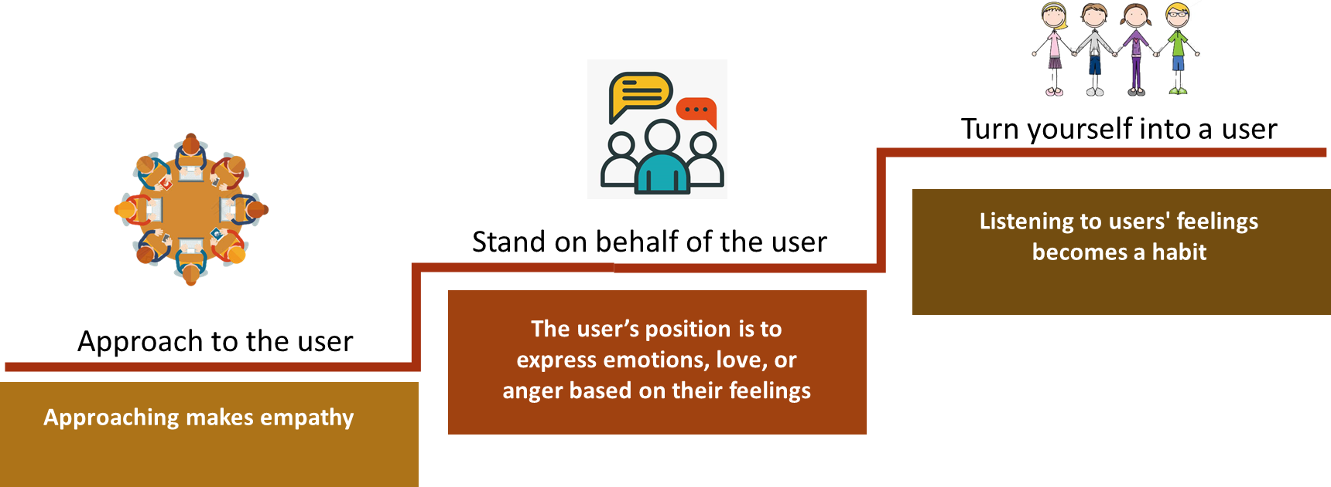
2.2 New Concepts of NPS
Concept 2— User-driven

Slide 22
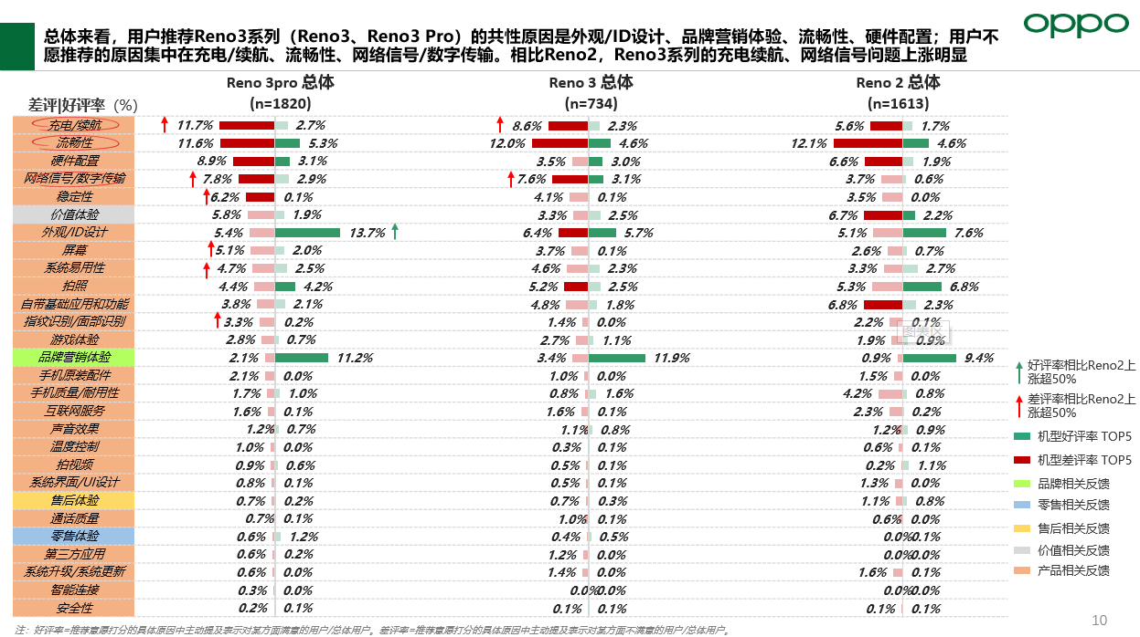
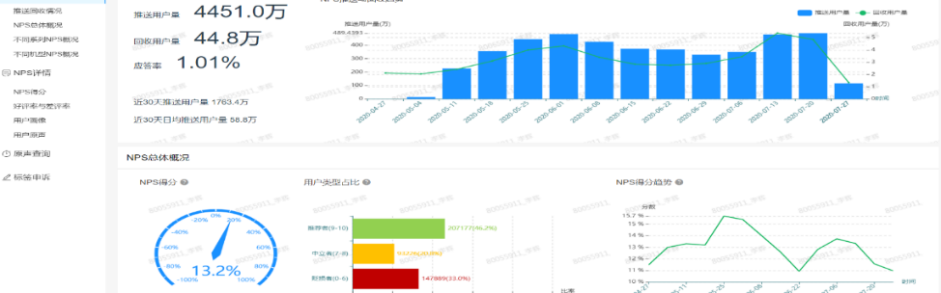
2.2 New Concepts of NPS
Concept 3—Measure in time to restore the true feelings of users
According to the peak-end law, user’s experience needs to be measured in time
After experiencing a thing, all we can remember is the experience at the peak and end. And the proportion of good and bad experiences in the process, and the length of time between good and bad experiences almost have no effect on memory. So after the peak, the faster the end appears, the more impressive this thing left us.
Establish NPS label system, build IT platform, real-time monitoring

Slide 23
2.2 New Concepts of NPS
Concept 4—Pay attention to detractors and reduce bad profits
High
When users feel that they have been ignored, or forced, the profits made by the company under these circumstances are bad profits.
Bad profits are shown by people who buy the company’s products, and these people are called “detractors"
On the contrary, good profits are realized through the sincere cooperation of customers, and those who generate good profits are referred to as “promoters"
Good profits
Rate of profit
Neutral profits
Bad profits
Low
Detractors
Passives
Promoters
Low
NPS
High
Priority 1: detractors
Priority 2: promoters
Priority 3：psssives
Reduce bad profits:
Reduce negative feedback rate
Invest in core users:
Increase the positive rate and reduce the negative rate
Discover potential promoters:
Reduce the negative feedback rate and increase the positive rate

Slide 24
2.2 New Concepts of NPS
Concept 5—Establish a user-centered quality culture
Short story: The formation of any kind of "culture" includes the four processes of "guiding, identifying, solidifying, and inheriting"
Monkey tells offspring how to soak potatoes
Inheriting
NPS culture
All monkeys soak in water before eating potatoes
Solidifying
Improvement
system
More and more monkeys learn that potatoes soaked
in water are more delicious and follow
Business
success
Identifying
The monkeys around start to try
NPS improvement
A monkey finds that potatoes soaked
in water are more delicious
Guiding
NPS introduction

Slide 25
2.3 Application of NPS concept
Case：
Before 2019, the NPS survey of the product was carried out 7 days after the release through a telephone return visit. And then in 2019, the product NPS system introduced was divided into 1/6/18 months for investigation. In 2020, it began to import overall NPS, covering marketing, retail, products, after-sales.
User's short-term experience
User’s full life cycle experience
Analysis:
Only focus on user experience within 7 days or 1 month;
Focus only on the experience of using the product (a single stage of the user journey)
Analysis:
The user's full life cycle includes four stages: marketing, retail, products, and after-sales.
The product experience needs to cover the user's entire replacement cycle

Slide 26
Conclusion
What is Strategic NPS？
How likely are you to recommend our product/service to a friend or colleague? 0-Not at all likely，10-Extremely likely.
2. For our customer service，what is Service NPS？
How satisfied are you with this after-sales service? Based on your experience, please rate from 1 to 10 points. 1-Very Dissatified,10-Very Satisfied.
3. What are new concepts of NPS？
Focus on the user's full life cycle experience
User-driven：approach to the user；stand on behalf of the user; turn yourself into a user
Measure in time to restore the true feelings of users；
Pay attention to detractors and reduce bad profits；
Establish a user-centered quality culture.

Slide 27
Thanks
Keep Standard in Mind Strive for Better Service

