Slide 1
How to Conduct OPPO NPS Survey
2021 Global NPS Promotion & Service Standardization Training
Ryan

Slide 2
Training Objectives
Through one-hour learning, you will get:
Learn how OPPO company conduct NPS survey, and understand the direction of NPS improvement;
Learn the service NPS survey system and data interpretation methods, and establish an NPS way of thinking;

Slide 3
CONTENTS
目录
1
How to Conduct Strategic NPS
2
How to Conduct Service NPS
3
NPS is Not Only a Score

Slide 4
01
How to Conduct Strategic NPS
PART ONE
  1.1 NPS Monitoring System
  1.2 Introduction of OPPO NPS survey

Slide 5
1.1 NPS Monitoring System
Question
Monitoring
Target
Strategic NPS
您有多大可能性把我们OPPO产品/品牌推荐给您的朋友或同事？ 0分表示非常不可能，10分表示非常可能。
How likely are you to recommend our product/brand to a friend or colleague?
0-Not at all likely，10-Extremely likely
解决公司及业务系统的方向问题
Solving the direction problem of the company and business
外部第三方调查
Third party investigation
check
support
Service
NPS
您对本次维修过程的满意程度如何？请根据您的满意程度打分。从1-10分，1分表示“非常不满意”，10分表示“非常满意”。
How satisfied are you with this after-sales service? Based on your experience, please rate from 1 to 10 points. 1-Very Dissatified,10-Very Satisfied
第三方调查
内部日常监测
Third party investigation
And internal monitoring
解决具体业务的改善问题
Solving specific business issues

Slide 6
1.1 NPS Monitoring System
OPPO NPS is the cumulative reflection of users' experience of each contact point of OPPO device
Strategic NPS
（ Level-one Indicator ）
OPPO NPS
R=XX
R=XX
Service NPS
（ Level-two indicator ）
On-boarding
Selection fitting
Compare & decision
Check-out process
Delivery
Return&
exchange
Use of product
Customer service
NPS管理方法其实是协助我们进行顾客体验的根因分析，找出优化方向后，持续改善顾客体验，并持续追踪改善效果，不断迭代的一种顾客体验管理制度。
The NPS management method is actually a continuously iterating the customer experience management system that assists us in analyzing the root cause of the customer experience. And after finding the optimization direction, we continuously improve the customer experience, and continuously track the improvement effect.
R=XX
R=XX
Satisfaction of
Key factors
（level-three indicator）
Discount
Being friendly
Speed of return

Slide 7
1.1 NPS Monitoring System
Service NPS：How satisfied are you with this after-sales service? Based on your experience, please rate from 1 to 10 points. 1-Very Dissatified,10-Very Satisfied
Why does service NPS use customer satisfaction instead of real Net Promoter Score？
Service is to support the company’s strategic NPS improvement through indirect contributions.
When a user goes to SC to repair the phone, asking about the user’s satisfaction is more in line with the user’s current feeling.
If we asked about the user’s willingness to recommend, the user’s relatives and friends are required to use the OPPO phone and the phone is malfunctioning. The situation is rare.

Slide 8
1.2 Introduction of OPPO NPS Survey
“In June 2020, the company's decision-making committee decided to introduce the NPS system and regard NPS as the company's current first-level indicator”
“In 2020, the company made a clear strategic declaration of ‘All for one, with user experience as the core’”
“In 2021, all company’s business departments will enter a stage of comprehensive NPS promotion and experience improvement, and firstly strive to reach the top 2 in the industry in China’s mobile NPS rankings”

Slide 9
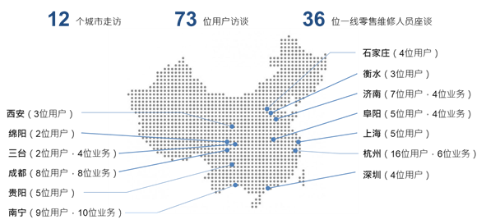
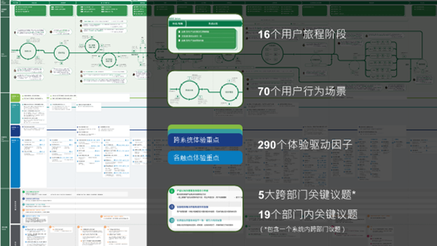
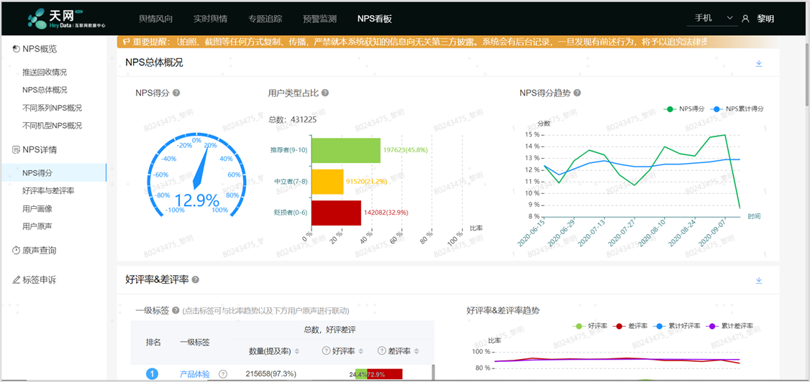
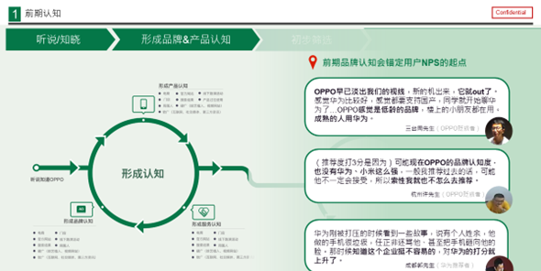
1.2 Introduction of OPPO NPS Survey
2020.08
Making customers Interview
2020.09
Sorting out the key journey stages
2020.11
Establishing NPS monitoring system
步骤：采用用户旅程地图（User Journey Map)工具，梳理出用户全生命周期的关键旅程阶段、用户行为和体验驱动因子
结果：16个用户旅程阶段，70个用户行为场景，290个体验驱动因子，5大跨部门关键议题，19个部门内关键议题
Using the User Journey Map tool to sort out the key journey stages, user behaviors and experience driving factors of the user's full life cycle
步骤：根据前期梳理的关键旅程，确认用户行为以及体验驱动因子，并导入NPS监测体系，进行实时监测
结果：NPS数据看板，包括总体情况、不同系列、不同机型、用户画像、用户原声；服务NPS数据看板，包括NPS值、关键驱动因子
Importing experience driving factors into the NPS monitoring system for real-time monitoring
步骤：一、二、三线城市走访，用户访谈，一线维修人员座谈
结果：用户体验阶段、用户痛点、一线工作人员的实际现状
Collecting a large amount of first-hand data, including user experience stage, user pain points, and actual status of front-line staff

Slide 10
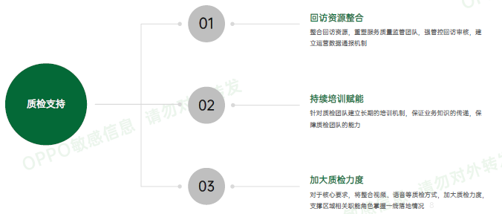
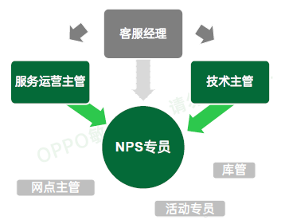
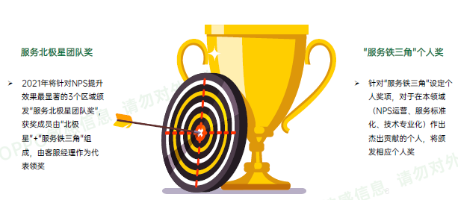
1.2 Introduction of OPPO NPS Survey
Landing guarantee
Q1. 2021
Clearing responsibilities
Building a professional team
Staff training
Service Manager
mobilization
Service concept delivery
Competition of service concept
Management tools ：
NPS dashboard
Customer journey map
Service countermeasures
NPS specialist
Closed loop management：
Weekly improvement
Monthly check
Quarterly review
Annual summary
NPS训练营：抓关键角色，提服务意识，强业务能力
CC支持：回访资源整合，持续培训赋能，加大质检力度
区域帮扶：区域资料准备，专项帮扶，跟进提升
激励升级：服务北极星团队奖，“服务铁三角”个人奖
NPS training camp: grasping key roles, improving service awareness, and strengthening business capabilities
CC support: resource integration, continuous training and empowering, and intensified efforts
Assistance for regions: giving special assistance and improvement suggestion
Incentive Upgrade: Service Polestar Team Award, "Service Iron Triangle" Individual Award
服务铁三角：客服经理，服务北极星保证方向正确；NPS专员，NPS运营官家，负责日常运营；服务运营主管，标准化承接，对执行结果负责；技术主管，技术专业化承接，对专业化落地效果负责
Customer service manager ensures that the direction is correct; NPS specialist is responsible for daily operations; Service operation supervisor is responsible for undertaking SST and execution results; Technical supervisor is responsible for the effect of professionalization:
Service operation officer
Service specification upgrading
Promotion landing: SST Training
Starting caring service
Technology officer
NPS Training Camp, Technology Branch
Professional technician image
Professional repairing skill
Professional communication skill

Slide 11
02
How to Conduct Service NPS
PART TWO
  2.1 Plan of overseas service NPS
  2.2 Process of overseas service NPS
  2.3 Introduction to key steps

Slide 12
2.1 Plan of Overseas Service NPS
2021年1月
Jan. 2021
2021年3月
Mar. 2021
2021年4-5月
April & May2021
项目成立
Projecting
方案实施
Implementing
总部赋能
Empowering
成立海外NPS项目组，从部门执行长到相关业务组负责人，全力参与海外NPS推广工作；设立NPS推广专员
方案敲定，参照中国区先行经验，根据海外实际情况，确立海外NPS推广整体方案和节奏
资源助力，整合现有公司战略NPS资源，以及海外网点建设、线上服务等管理经验
Setting up an overseas NPS project team: from department chiefs to relevant business team leaders, all fully participate in overseas NPS promotion work; setting up NPS promotion specialist
Plan preparation: with reference to the first experience in mainland China and the actual situation overseas, establishing the overall plan and rhythm of overseas NPS promotion
Resource assistance：integrating the existing company's strategic NPS resources, and management experience in overseas on-site and online services, etc.
文化及方法赋能：通过文化活动、会议培训、案例等形式在总部及全区域建设NPS文化
业务基线与考评体系搭建：以NPS为核心进行本地问题洞察；搭建数据监控仪表盘以及业务基线
区域试点：搭建区域NPS闭环管理流程，为全球推广落地树立成功标杆
Culture and method empowering: building NPS culture in the headquarters and the entire region through cultural activities, conference training, case studies, etc.
Business baseline and evaluation system construction: with NPS as the core for local problem insight; building data monitoring dashboard and business baseline
Region pilot: building a regional NPS closed-loop management process; setting a successful benchmark for global promotion.
NPS训练营：客服经理层，激发管理意识；一线核心人员：部署NPS运营的意识（协同本地化，挖掘问题解决问题）；一线工作人员, 通过标准化作业流程保证落地执行
CC支持：整合海外回访资源，持续进行培训赋能，加大质检力度
备件组/技术组：提供专业技术方案，助力专项提升
NPS training camp: grasping key roles, improving service awareness, and strengthening business capabilities
CC support: resource integration, continuous training and empowering, and intensified quality inspection efforts
Spare parts group/technology group: giving special assistance about spare parts management and technology support, and improvement suggestions.

Slide 13
2.1 Plan of Overseas Service NPS
推广任务: 5月前完成全区域总部特训，8月前完成全区域全员文化理念宣贯 (总部提供材料&辅导）
Training task: To complete training for the regional headquarters by May, and to complete the training and implementation of all staff in every regions by August (Headquarters will provide training materials and give assistance）
2021年2月 Feb. 2021
成立海外NPS专项
形成初步方案
Established overseas NPS special project
Form a preliminary plan
2021年5月 May. 2021
NPS问卷本地测试结果输出
方案持续优化
海外NPS&标准化训练营
NPS local test result output
Continuous optimization
NPS & SST camp
2021年9月 Sep. 2021
重点区域试点（EG,MY,AU)
试点区域人员二次赋能
速赢点打造
Pilot projects in key areas (EG, MY, AU)
Re-training of personnel in pilot areas
Quick-win points creation
2021年4月 Apr. 2021
NPS问卷本地测试
第一次海外客服经理会议
海外总部线上赋能
NPS survey local trial
The first overseas customer service manager meeting
Online training of overseas headquarters
2021年6月 Jun. 2021
全区域全员转训，一线赋能
转训结果验收，人员考核
All employees accept training; empowering for all staff
Check&Acceptance of transfer training results; personnel assessment
2021年12月 Dec. 2021
试点总结分享，打造成功标杆
2022年NPS工作规划
Pilot summary and sharing to create a benchmark for success
NPS Work Plan in 2022

Slide 14
2.2 Process of Overseas Service NPS
STEP2
Distribute the survey
STEP4
Collect data
STEP6
Analyze and Improve
STEP8
Track implementation
According to the user's contact information on the repair order, selecting SMS, email, or telephone return visit
Integrate Email, SMS and telephone return visit data into WCSM system
Identifying priority improvement items based on NPS score and mention rate
Tracking the implementation of service solution and adjust in time
STEP1
Confirm survey object
STEP3
User fills out the survey
STEP5
Present NPS data
STEP7
Find solutions
STEP9
Adjust the survey
According to ways which users send for repair, confirming survey object
As for Mail/SMS survey, user fills in by himself; as for telephone return visit, CC record Users’ answer
Developing NPS dashboard, after integrating various channel data, presenting NPS value and service pain points
According to the priority improvement items, identifying the key points, and formulating the service countermeasures (one region and one policy)
According to the improvement situation, adjusting the content of the survey, confirming the main pain points and strengthening monitoring

Slide 15



2.3 Introduction to Key Steps: Confirm Survey Object
Object Three：
Users who send for repairing via dealers, salesman, or operators
Object One:
Users who send for repairing on-site
Object Two:
Users who send for repairing by mailing
Dealers/salesmen/operators
Users
Go to
Service Center
Users
Mailing
Service Center
Users
Service center

Slide 16
2.3 Introduction to key steps: Distribute the survey
Type 1: Users who send for repairing on-site
A. There is an email address: the system will send an E-mail at 8 am on the second day after the repairing is completed; if the user has not completed it, entering telephone return visit
B. No E-mail address: The system will send a text message at 8 am on the second day after the repairing is completed; if the user has not completed it, entering telephone return visit
Type2: Users who send for repairing by mailing
A. There is an email address: the system will send an E-mail at 8 am on the 4th day after the repairing is completed; if the user has not completed it, entering telephone return visit
B. No E-mail address: The system will send a text message at 8 am on the 5th day after the repairing is completed; if the user has not completed it, entering telephone return visit
Type3: Users who send for repairing via dealers, salesman, or operators
* Email and SMS survey links are set to be valid for 7 days
Flowsheet
NPS E-mail Survey
Yes
Reply or not
Yes
50%
NPS SMS Survey
All users
Having E-mail address
No
Ending
No
50%
Telephone return visit
*All users are determined according to the type of maintenance, not including abandoning maintenance

Slide 17
2.3 Introduction to Key Steps: Distribute the Survey
Dear Customers,
Thank you for your trust in OPPO service. Please tell us about your experience
Q1：How satisfied are you with this after-sales service? Based on your experience, please rate from 1 to 10 points. 1-very dissatisfied, 10-very satisfied.
Q2：（9-10 points）We’re delighted to hear your experience was great. Which of the following aspects are you mainly satisfied with?
（7-8 points) Thanks for your feedback. What things can we improve?
（1-6 points）We’re sorry to hear your experience was not good. What things can we do better?
Thanks again for your participation. If you have any questions, please contact us with OPPO Hotline on ******. Have a nice day!

Slide 18
2.3 Introduction to Key Steps: Distribute the Survey
Type 1:
Users who send for repairing on-site
Type2: Users who send for repairing by mailing
Type3: Users who send for repairing via dealers, salesman, or operators
Q2：（9-10 points）
(1) Convenient to inquire the official after-sales information
(2) Convenient appointment for repair
(3) Easy to find Service Center
(4) Comfortable and tidy environment
(5) There was a receptionist and maintenance process guidelines in Service Center
(6) Service staff was friendly and polite
(7) Clearly tell me what the issue was
(8) Professional and effectively solved the issue
(9) Fast repair
(10) Resonable repair costs or discounts
(11) Transparent repair costs
(12) Short queueing time
(13) Service Report was provided
(14) Other intimate service (free gifts, drinks, snacks)
(15) Convenient international warranty
(16) Others，___________(please fill out）
Q2：（9-10 points）
(1) Service staff was friendly and polite
(2) Clearly tell me what the issue was
(3) Clearly tell me how long the repair time was
(4) Professional and effectively solved the issue
(5) Reasonable repair costs or discounts
(6) Service Report was provided
(7) Short delivery time and fast repair
(8) Convenient to pay
(9) Free delivery charges
(10) Others，___________(please fill out）
Q2：（9-10 points）
(1) Salespersons or dealers were friendly and polite
(2) Salespersons or dealers could clearly tell me what the issue was
(3) Salespersons or dealers could clearly tell me how long the repair time was
(4) Effectively solved the issue
(5) Reasonable repair costs or discounts
(6) Service Report was provided
(7) Short delivery time and fast repair
(8) Convenient to pay
(9) Free delivery charges
(10) Others，___________(please fill out）

Slide 19
2.3 Introduction to Key Steps: Distribute the Survey
Type 1:
Users who send for repairing on-site
Type2: Users who send for repairing by mailing
Type3: Users who send for repairing via dealers, salesman, or operators
Q2：（1-6 points）、（7-8 points）
(1) Inconvenient to find Service Center
(2) Environment is not good enough
(3) Service staff was unfriendly and ignored me
(4) Data lost after repair
(5) Communication skill was not good enough
(6) Some wrong information was provided
(7) Attitude was not good enough, such as arguing with me
(8) Didn't effectively solve the issue
(9) Waiting time for queuing, repair, return and exchange was a little long
(10) Unreasonable charge and high price
(11) Phone damaged after repair
(12) Waiting spare part for long time
(13) New issues came out after repair
(14) Didn't call me to fetch the phone in time
(15) Failure to inform me the warranty
(16) Inspection result was controversial
(17) Others，___________(please fill out）
Q2：（1-6 points）、（7-8 points）
(1) Inconvenient to inquire the official after-sales information
(2) Service staff was not friendly enough
(3) Couldn't clearly tell me what the issue was
(4) Couldn't clearly tell me how long the repair time was
(5) Didn't effectively solve the issue; repeated repair
(6) Unreasonable charge and high price
(7) Didn't provide Service Report
(8) Delay of delivery
(9) Inconvenient to pay
(10) Data lost after repair
(11) Phone damaged after repair
(12) New issues came out after repair
(13) Others，___________(please fill out）
Q2：（1-6 points）、（7-8 points）
(1) Inconvenient to inquire the official after-sales information
(2) Salespersons or dealers were not friendly enough
(3) Salespersons or dealers couldn't clearly tell me what the issue was
(4) Salespersons or dealers couldn't clearly tell me how long the repair time was
(5) Didn't effectively solve the issue; repeated repair
(6) Unreasonable charge and high price
(7) Didn't provide Service Report
(8) Delay of delivery
(9) Inconvenient to pay
(10) Phone damaged after repair
(11) Data lost after repair
(12) New issues came out after repair
(13) Others，___________(please fill out）

Slide 20
2.3 Introduction to Key Steps: Analyze and Improve
High mention rate
100%
优先改善Priority 用户提及率高且NPS分数低，应优先改善，减少用户不满 User mention rate is high and NPS score is low, priorities should be improved to reduce user dissatisfaction | ➁ 超越期待Exceed expectations 用户提及率高且NPS分数高，需持续发力， 突破用户预期，并作为卖点包装宣传 User mention rate is high and NPS score is high, need to continue to work hard to break through user expectations, and as a selling point packaging promotion
➃ 最低优先Lowest priority 用户提及率低且NPS分数低，可保持观察，留意异常波动 User mention rate is low and NPS score is low, you can keep observation and pay attention to abnormal fluctuations | ➂ 稳步提升 Continuous improvement 用户提及率低且NPS分数高，可稳步提升 Low user mention rate and high NPS score, which can be steadily improved
例：服务人员是否能有效解决手机问题
NPS 26.6%；提及率 90.1%
eg: Whether the service staff can effectively solve the mobile phone problem
NPS 26.6%;Mention rate 90.1%
Low mention rete
0%
0%
100%
Low NPS
High NPS

Slide 21
2.3 Introduction to Key Steps: Find Solutions
STEP 7.1
STEP 7.2
STEP 7.4
STEP 7.3
Conducting research
on the status quo
Identifying key
issues
Consensus on
the solution
Solutions
and implementation
用户视角：回访数据分析，满意度和一小时快修率；用户投诉
员工视角：门店探访，人员座谈
From user perspectives : Return visit data analysis, customers satisfaction and one-hour flash fix rate; data analysis of user complaints
From staff perspectives : store visits; service staff interview
依据用户旅程地图调研，梳理确认关键议题
相关团队成员，以工作坊方式进行解决方案共创，头脑风暴
Based on user journey map research, sorting out and confirming key issues
Relevant team members co-create solutions
各业务组就方案的有效性和可行性进行评估，达成共识后，总部协调资源，各部门完善解决方案
Each business group evaluates the effectiveness and feasibility of the plan, and after reaching a consensus, the headquarters coordinates resources and each department improves the solution
整合并绘制成最终的服务策略（每一项问题一个服务对策）
区域整合团队力量，确保措施落地，跟进实施效果
Integrating and drawing into the final service strategy (one service solution for each problem)
Strengthening integration of team to ensure the implementation of measures and tracking implementation effects

Slide 22
03
NPS is Not Only a Score
PART THREE
  3.1 Exceeding Score: From Net Promoter Score to
  Net Promoter System

Slide 23
3.1 Exceeding Score: From Net Promoter Score to Net Promoter System
1) NPS is not only a number, but also a dynamic measurement mechanism. Through different measurement and analysis methods, we need to find problems and improve them immediately.
2) As the basis of business strategy, Net Promoter System help us continuously monitor the improvement of experience, form an endless loop of experience optimization, and finally create a user-centric culture.
Net Promoter Score
01
02
03
Dividing users into three categories
Calculating
Improving NPS
Net Promoter System

Slide 24
Conclusion
1. Service NPS：How satisfied are you with this after-sales service? Based on your experience, please rate from 1 to 10 points. 1-Very Dissatified,10-Very Satisfied
2. NPS promotion task: completing the training and implementation of all staff in every regions by August
3. Process of overseas service NPS :
Confirm survey object
Distribute the survey
User fills out the survey
Collect data
Present NPS data
Analyze and Improve
Find solutions
Track implementation
Adjust the survey

Slide 25
Thanks
Keep Standard in Mind Strive for Better Service

